Slide 1





Introducing Community Health Agents (CHAs) to accelerate achievement of MDGs 4 and 5 - A Randomized Cluster Controlled Trial
GEHIP AHI Site Visit Meeting, June 23, 2015, Accra, Ghana
Notes:
Thank you for inviting me to this meeting. My name is Colin Baynes. I am the Program Manager for the Connect Project, a randomized cluster controlled trial of the introduction of a paid, professionalized CHW cadre that implements an integrated MNCH work package in rural Tanzania. It is great to be here to present the evaluation of the community health worker intervention which Ineke has just presented. As Ineke has said, our project, called Connect, conducted a practically identical recruitment, selection, training and implementation process as the SolidarMed Project. Therefore, during this presentation, I will highlight very briefly the intervention itself and move on to present pieces of the program evaluation. I should also, acknowledge the Connect Team at the Ifakara Health Institute, Columbia University and the Tanzanian Training Center for International Health who partnered to conduct this project.

Slide 2
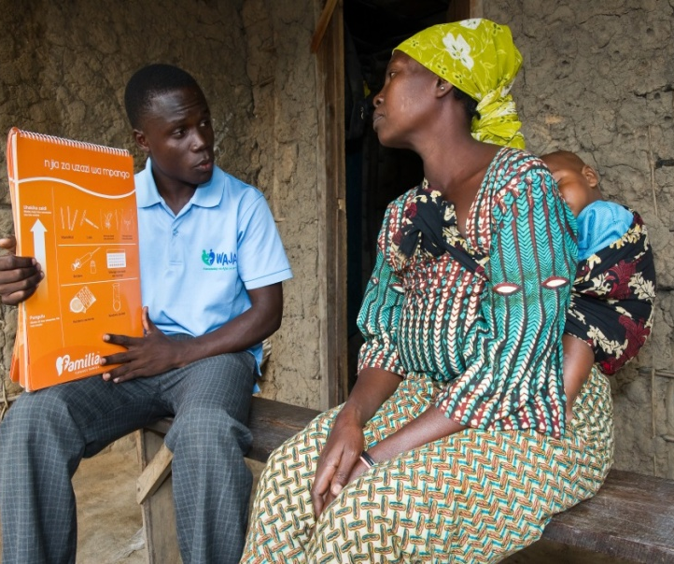
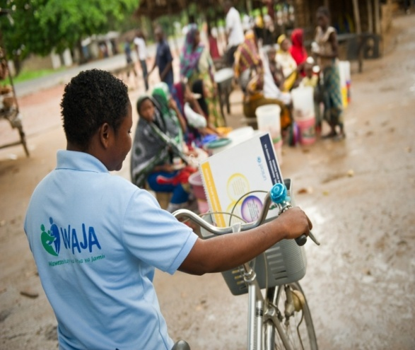
Introduction
    Responds to call for national CHW program (MOHSW, 2007, 2011).
    Operationalizes a national model for introducing CHW into government system.
    Designed to test the health impact of CHW in to the health system, and assess the feasibility of CHW introduction.
    A randomized controlled
    experiment comprised of 50 treatment and 51 comparison villages in 3 districts.
Notes:
First of all, to acquaint you with the design of the research, the design prioritized first and foremost the need to assess the health and mortality impact of deploying a cadre of CHW. For this, it draws on the Ifakara Health Institute’s health and demographic surveillance systems platform, which covers 50 intervention villages, where CHW have been posted since August 2011, and 51 comparison villages which have not been exposed to the intervention, to assess the mortality impact of CHW deployment. Secondarily, the study aimed to assess the feasibility to sustain the effects or impact detected through the trial within local health system structures. To this effect, the study has embedded longitudinal qualitative research and discrete operational studies to understand how the system has changes during the roll out of this program. Altogether, this forms a randomized controlled experiment of the country’s vision of a national CHW program that contextualizes outcomes with feasibility and explanatory information with the end goal of guiding policy development for national primary health care strategy.

Slide 3
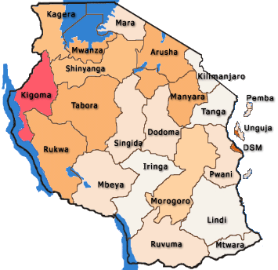
Connect Project Intervention Areas
Kilombero and Ulanga districts in Morogoro region
Rufiji district in Pwani region
Collaborating Partners:
Ifakara Health Institute (Tanzania)
Columbia University (USA)
Tanzania Training Center for International Health (Tanzania)
MoHSW (Tanzania)
Project is funded by:
Doris Duke Charitable Foundation (USA)
Comic Relief (UK)
Notes:
Very quickly, these are the study settings. As you can see, the project is conducted in three rural districts situation in two different cultural and ecological settings of the country, Kilombero and Ulanga districts in Morogoro region in the interior, southwest of the country, and Rufiji district in Pwani region on the coast.

Slide 4
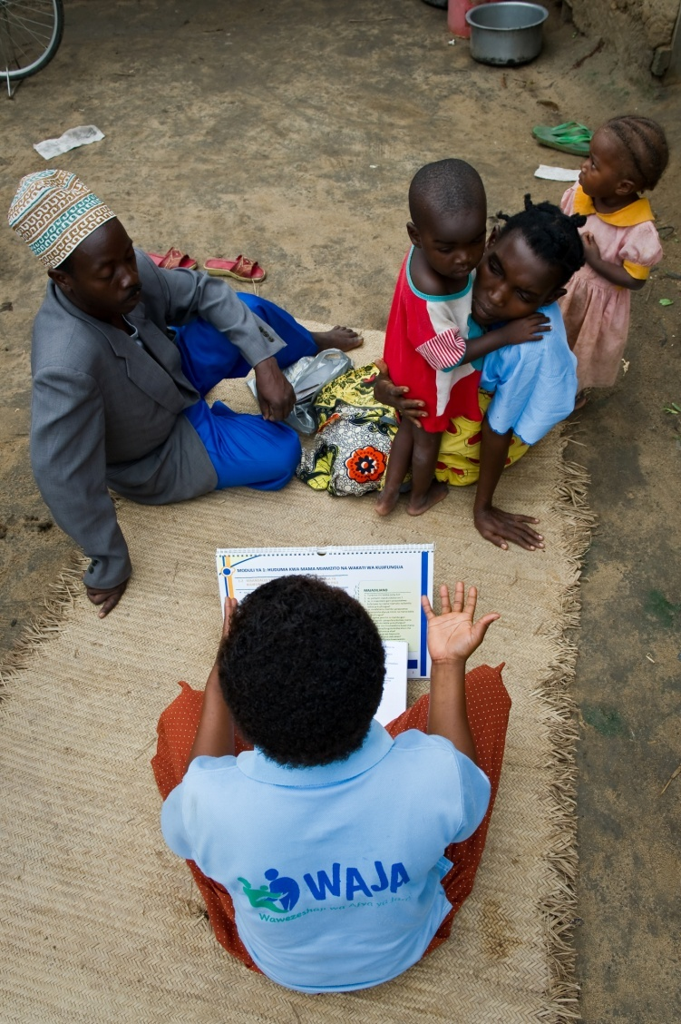
Intervention Design
Recruitment of CHA – collaboration between local government and communities, selection by communities.
Training program, nine-months, emphasizes integrated, community primary health care;
  Focused on MNCH, including IMCI and iCCM,
  Optimized for eligibility for government scheme of services.
Deployment and management of CHA cadre by the local health system.
  CHW employed and paid by local government authorities.
  Project backstopping to ensure delivery of essential health system supports
Notes:
To quickly recap what Ineke just presented, the intervention comprised the holistic introduction of CHW into the local health system – recruitment and selection of CHW by way of enabling initiative of communities to develop job description and scopes of work for CHW, village government and community selection processes; a nine-month training program for CHW that was optimized for eligibility for the national scheme of service and adoption of the program by national government, and imparted on CHW competencies to perform an integrated maternal, newborn and child health service package, which includes case management for malaria, pneumonia and diarrhea for under-fives. The intervention was managed by the district health systems, but this was backstopped by enabling activities of the project to ensure essential system supports to the CHW.

Slide 5
CHW Services Integrated around six pillars of the health system
Notes:
This diagram represents the logic model which guided the design of the intervention and its evaluation. The introduction of CHW is a systems intervention in the sense that it introduces strategic and organizational change in all aspects of the local health system, as represented by the six health system ‘building blocks’ which were proposed by the World Health Organization. The introduction of CHW entails change in each of these respective areas, which, in turn, produces change in the output of the local health system. We hypothesized that the improvements in health systems outputs – i.e. quality, availability and accessibility of services, and the efficiency/responsiveness of the health system, would incur improvements in the climate of demand for care, and, in turn, better health behavior that would lead to increased survival of mothers and children in the study area.

Slide 6
CHA Service Delivery Package
Notes:
This diagram reflects the service delivery package of the CHA, which was designed to address demands of strengthening both the community to health facility and life-cycle continuum of care. CHA perform a combination of preventive and promotive services which focus on educating the community and facilitating timely referral to higher levels of the formal health system for key maternal, newborn and child health services, and key curative services for addressing the key causes of death for children under five years of age. Altogether these address major causes of ill-health and the various stages of the pre-pregnancy to childhood life-course.

Slide 7
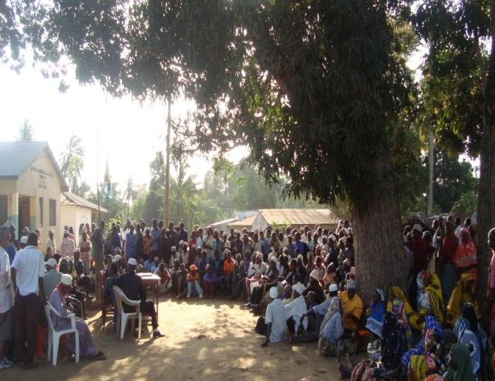
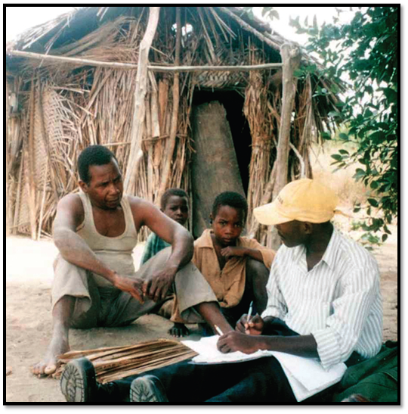
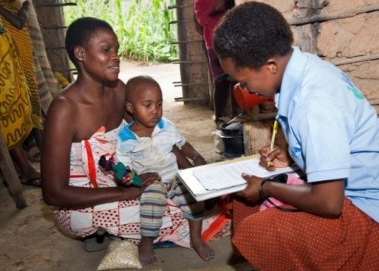
Evaluation on the following areas
Mortality and health trends and determinants
  Newborn and child health
  Reproductive health and family planning
Implementation processes
  Qualitative systems appraisals
  Quality of CHW services/performance
  CHW time and motion study
Costing analysis
  Training of CHW
  Deployment of CHW
Evidence to action
  Policy impact and sustainability
  Role of research and evidence based policy development
Notes:
With this, I will move into discussion of some baseline and preliminary results of our evaluation. It will follow the diagram I just described – presenting some of the key contextual findings from baseline – mainly looking at baseline health seeking patterns – that we believe highlight contextual influences on health care decision making, particularly for mothers and newborns; then moving onto results from different aspects of our process evaluation that examine the consequences and changes incurred by introducing CHW into communities and the actual productivity of the CHW workers while deployed. We will provide findings from the costing analysis which has been conducted during implementation, and lastly look at preliminary findings on the mortality impact of the intervention. It should be stated that these findings reflect preliminary, mid-line findings. These are not definitive or final, so please do not take them at such. If time permits, we will briefly highlight the process we are using to translate findings into policy development and drive public health system action that is based on actual evidence.

Slide 8
Midline Mortality Impact
Indicator | Baseline: Aug07-Jul11 |  | Midline: Aug11-Nov13
 | HR | P-value | HR | P-value
NMR (028days) | 0.95 | 0.68 | 1.00 | 0.98
PNMR (1-11mths) | 0.96 | 0.72 | 0.99 | 0.95
PIMR (12-59mths) | 1.05 | 0.53 | 0.79 | 0.03
U5MR | 0.99 | 0.93 | 0.93 | 0.24
Mortality Hazard Ratios
Notes:
We ran a discrete time hazard model with cluster adjustment.
Results showed:
a clear post-infant mortality rates (PIMR) effect of CHA. The PIMR at the midline were 19% lower in intervention as compared to comparison areas (p=0.02).
A possible emerging effects among post-neonates (PNMR). The PNMR at the midline were only 6% lower in intervention as compared to comparison areas.
However, there is no CHA impact on the neonatal mortality rates (NMR) at all. The NMR at the midline were only 10% higher in intervention as compared to comparison areas.
➔ that will translate into an overall under-five effect. Even the differences were not significant (p=0.32), the U5MR at the midline were 6% lower in intervention as compared to comparison areas.

Slide 9

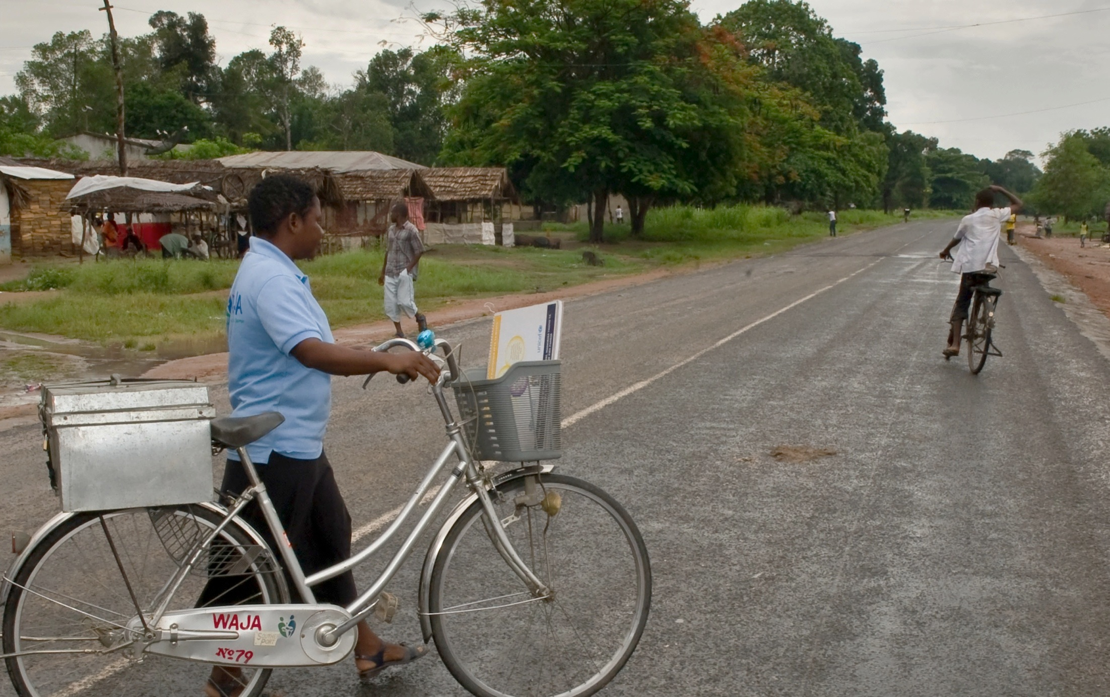
ASANTENI SANA!
Thank you!
(Thank you very much!)

