Slide 1
Preparedness and Response to Public Health Risks and Emergencies
Workshop Report
6th of January 2014

Slide 2
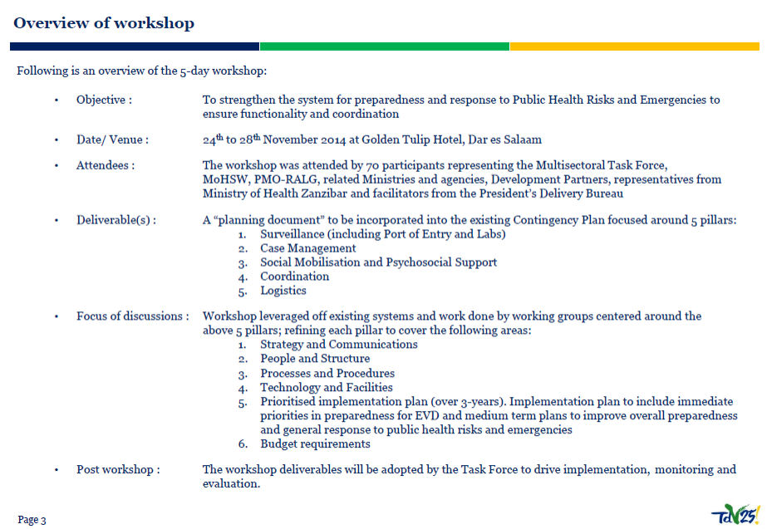

Slide 3
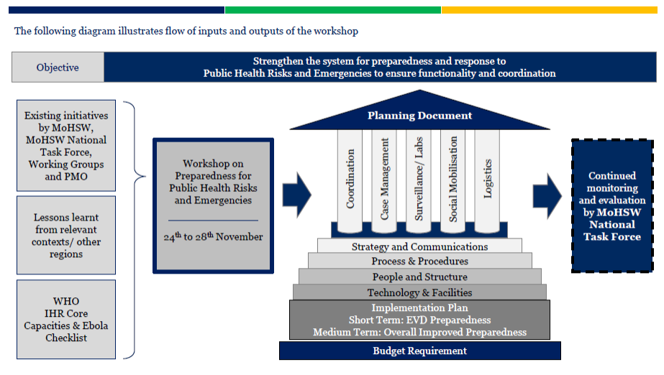
Overview of the workshop

Slide 4
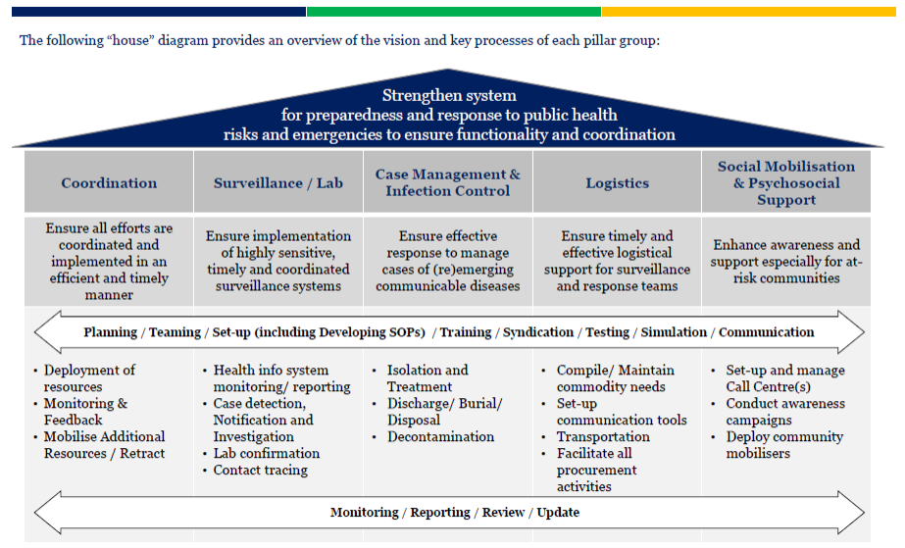
5 Pillars to strengthen preparedness and response to public health risk and emergencies

Slide 5
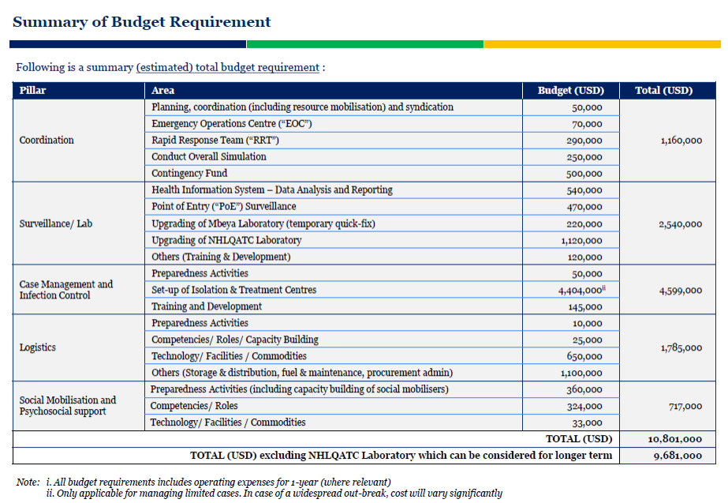

Slide 6
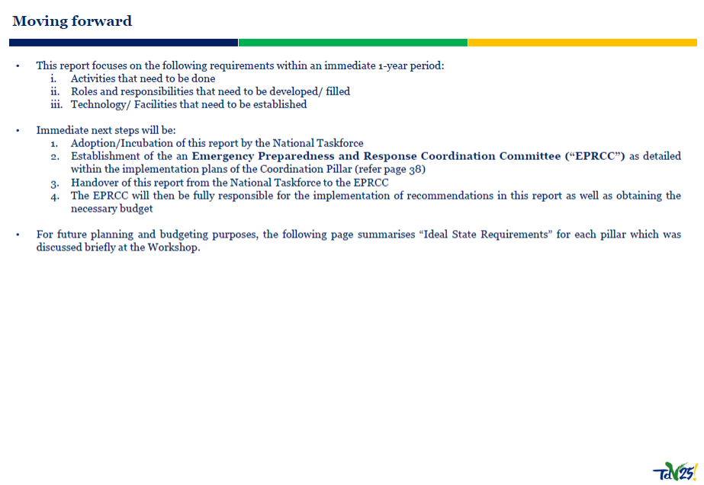
Moving Forward

Slide 7
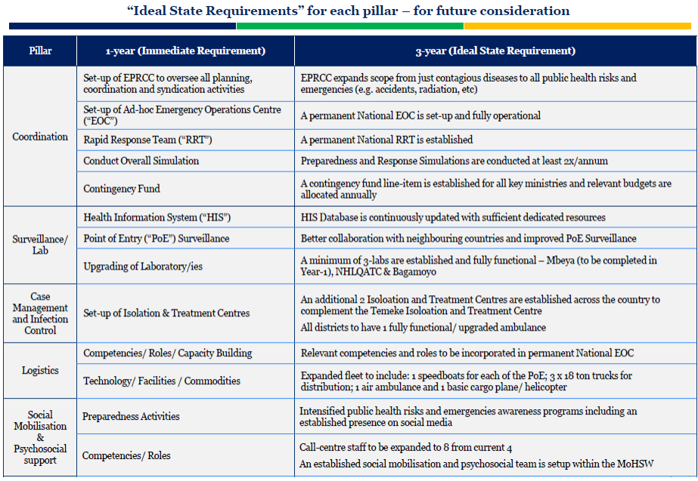

Slide 8
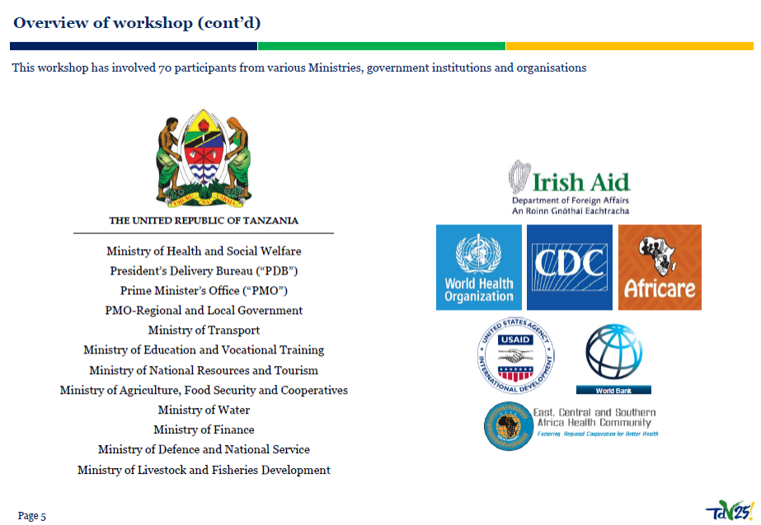
Acknowledgement

