Slide 1
Rapid Budget Analysis (RBA)
Health Sector
December 4, 2013

Slide 2
Overview
RBA is an annual exercise to provide inputs into
  General Budget Support Annual review,
  2014/15 Budget Preparations
  MKUKUTA progress,
  Sector reviews
  Big Results Now
This year, the DP RBA team worked closely with MOHSW HCF team involved in the Public Expenditure Review
  to jointly agree on health boundaries and approaches to analysis
Utilizes MoF’s detailed approved budget for FY12/13 & FY13/14 along with expenditure dataset from FY 12/13
DP RBA team: USAID, DANIDA and WB

Slide 3
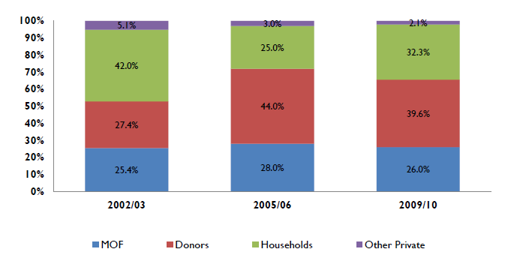
National Health Accounts (NHA)
The RBA represents only a fraction of overall Health expenditures in the country.
Financing Sources

Slide 4
Methodology
Define what constitutes Health.
Included
HIV/AIDS investments
Medical and Dental refunds
NHIF employer contributions
Child survival
Health transfers (District and Urban)
MOI
Excluded
NHIF contributions
Salary adjustments
Social welfare
Central level salaries for health staff at PMO-RALG
Total GOT expenditure used to calculate share of GOT spending on health Excludes a portion but not all of Consolidated Fund Support
  specifically excludes all repayment of principal
  but not interest payments and other items in State House and Public Debt/General Services.
Notes:
NHIF:
Pool for salary adjustments: don’t have the details by sector
PMO-RALG- because amount was insignificant

Slide 5
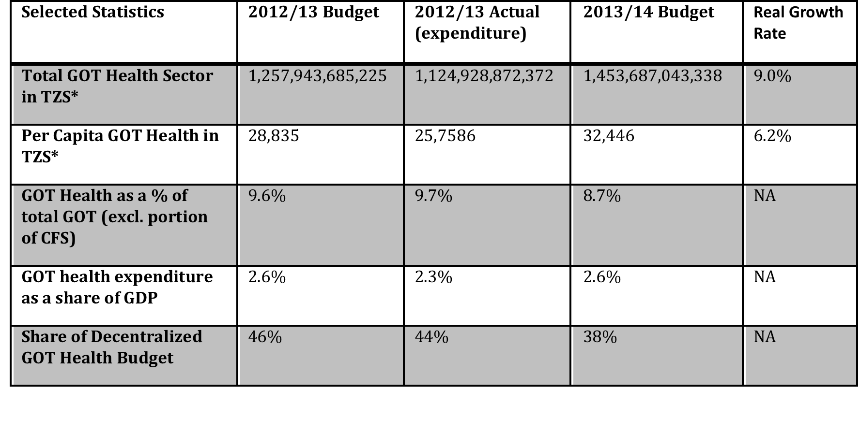
Summary Statistics

Slide 6
Strengths
Health budget has increased in nominal, real, and per capita terms in the last year
Non-basket foreign funding to the sector has increased, reversing the decline evidenced in the previous year’s RBA.
  The increase in non-basket foreign funding is particularly prominent in the area of medicines.
Unlike FY 11/12, execution of the FY 12/13 budget was consistently strong across both foreign and local-heath spending.

Slide 7
Weaknesses
Declining priority of the health sector. Declines in health basket funds and GoT local contributions.
Geographic inequality in Health Block Grant distribution amongst LGAs remains substantial.
78% of the budget increase is for medicines which is disease specific resulting in other building blocks and general health not receiving adequate resources.
Medicines budget is 90% donor dependent. Facility budget allocated to MSD has decreased by 28%
No increase in local contribution for family planning.*

Slide 8
Donor Dependency
Concern: Donor dependency and sustainability of health sector
Tanzania shows negative trend of government contribution to health
  Local contributions to the health budget has dropped by 7% to 19,336 Tshs. per capita
  Donor contributions, largely GFATM, have increased by 45%
  90% of medicines budget through the public sector is donor financed

Slide 9
Geographic Inequity
Highly unequal health block grant distribution amongst LGAs
Top 5 districts average 28,000 Tshs/capita (270% of national average)
Bottom 5 districts average 2,200 Tshs/capita (27% of national average)
LGA level per capita Health Block Grant Spending FY 13/14, as a multiplier of average per capita spending

Slide 10
Health in Context of Overall GOT
GOT Total Budget increased by 20% as compared to 9% increase for Health.
Health sector share declined from 9.6% in 2012-13 to 8.7% in 2013-14.
GOT Local contribution has increased by 22% and foreign contribution by 10%

Slide 11
Other Sectors
About 2/3s of the discretionary public spending was spent on the 6 Mkukuta priority sectors in 2012/13.
  Budget for these sectors has declined from 65.5% in 2012-13 to 64.6% in FY13-14
Water, energy and roads saw significant increases in the 2013/14 budget.
Trends in priority sectors spending

Slide 12
Conclusions and way Forward
Concerns:
  Donor funding ‘appears’ to be replacing GoT local investment.
    Donor funding is not predictable.
  Financial condition of MSD
  BRN seems to be the driving force of GoT fund prioritization.
    Phase 1 priority sectors are significantly underfunded which could possibly result in a delay in phase 2.
  Erratic disbursement of budgeted funds and transfers
  Increasing foreign debt service and tax collection 10% off target in Q1
Opportunities:
  Health is expected to be included in phase 2 of BRN.
    Minister is setting up delivery unit
  Advocate for geographic equity. Review LGA funds allocation formula.
  Health Care Financing Strategy: Develop approaches for strengthening domestic investment and fostering financial sustainability

Slide 13

Asanteni Sana

