Slide 1


ANNUAL HEALTH SECTOR PERFORMANCE PROFILE REPORT 2015
DAR ES SALAAM
DATE 26 TO 27 NOVEMBER 2015
PREPARED BY MONITORING AND EVALUATION SECTION

Slide 2
Presentation outlines
1
Process of developing the Annual Health Sector Performance Profile Report (AHSPPR) FY 2014/15
2
Status of HSSP III Indicators as of year 2014 updates
3
Impact Indicators
4
Coverage of Interventions
7
5
Health Systems Input and Output
6
5
Achievements, Challenges and Recommendations for the future plan

Slide 3
Key Links to Health Sector Data
http://dhis.moh.go.tz/portal
http://hfrportal.ehealth.go.tz
http://Opendata.go.tz

Slide 4
Process of developing the Annual Health Sector Performance Profile Report (AHSPPR) FY 2014/15
Step 1: Conducted consultations with Regions and Councils on DHIS2 data validation.
Step 2: Team of M&E Specialists including Universities, Health Research Institutes, International Technical Assistants (TAs), Major Hospitals and representation of M&E TWG members convened at Bagamoyo for DHIS2 analysis to produce 1st draft of the report.
Step 3. Draft report presented to M&E TWG for input
Step 4: Presentation to JAHSR for comments
Step 5: The MOHSW management approve the report to be presented

Slide 5
  Data sources and data quality assessment
Routine Data; for example: DHIS2, HRHSI, eLMIS, HFR, Vertical Programs, CCHP, etc
National Census Projection from the National Bureau Statistics (NBS) to generate denominators.
Data from periodic studies, National assessment, routine supervision and management were also included,
Finally triangulation of data were done to examine the validity and consistency of data.

Slide 6
Status of HSSP III Indicators as of year 2014 updates
Source: Triangulation from Health Sector Data Sources , 2014

Slide 7
Status of HSSP III Indicators as of year 2014 updates
Source: Triangulation from Health Sector Data Sources , 2014

Slide 8
Status of HSSP III Indicators as of year 2014 updates
Source: Triangulation from Health Sector Data Sources , 2014

Slide 9
Health Impact Indicators

Slide 10
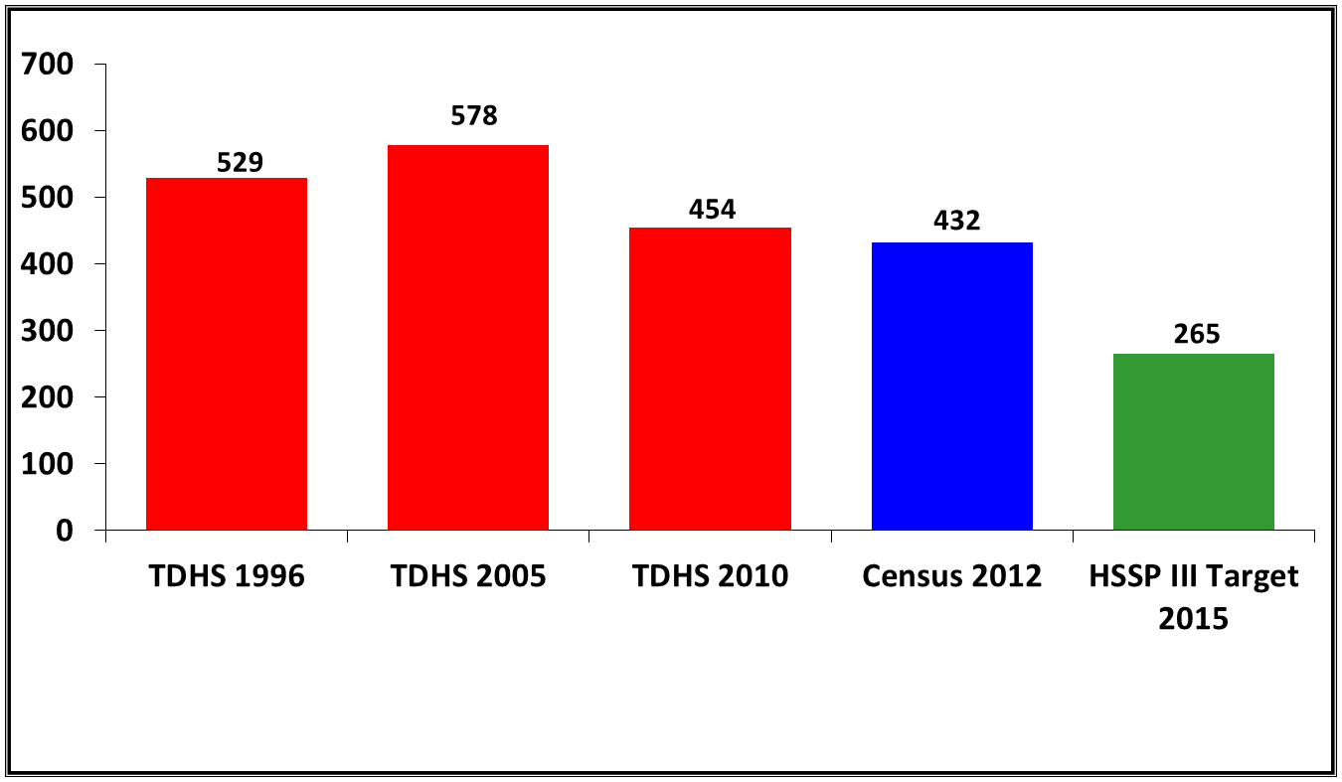
Trend in the Maternal Mortality Ratio per 100,000 Live Births
Trends in mortality for U5MR, IMR and NMR from Health Surveys
% National Trends in HIV prevalence.
Progress on MMR but still far from the target
Good progress for Under 1, Under 5 but infant Mortality but we have a challenge on Neonatal Mortality.
Good progress on HIV prevention
Source: Triangulation from Health Sector Data Sources , 2014

Slide 11
Estimated Maternal Mortality Ratio by Region, Tanzania, 2012 Census
Estimated Facility Based Maternal Mortality Ratio by Region Mainland Tanzania 2009 - 2012
Source: Tanzania Census, 2012

Slide 12
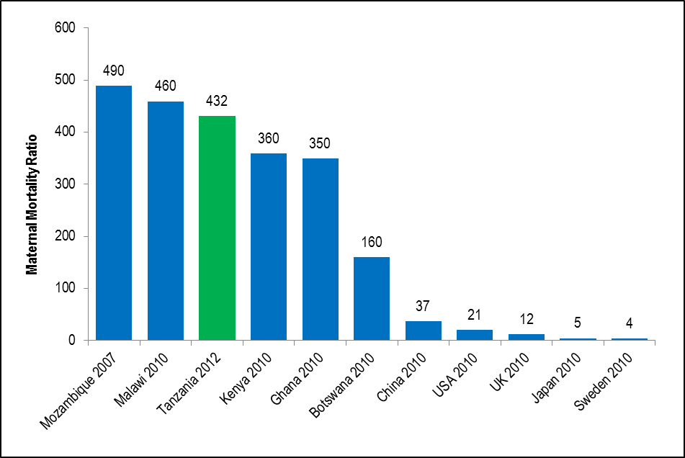
Maternal Mortality Ratio by Selected Country
Source: Triangulation from Health Sector Data Sources , 2014

Slide 13
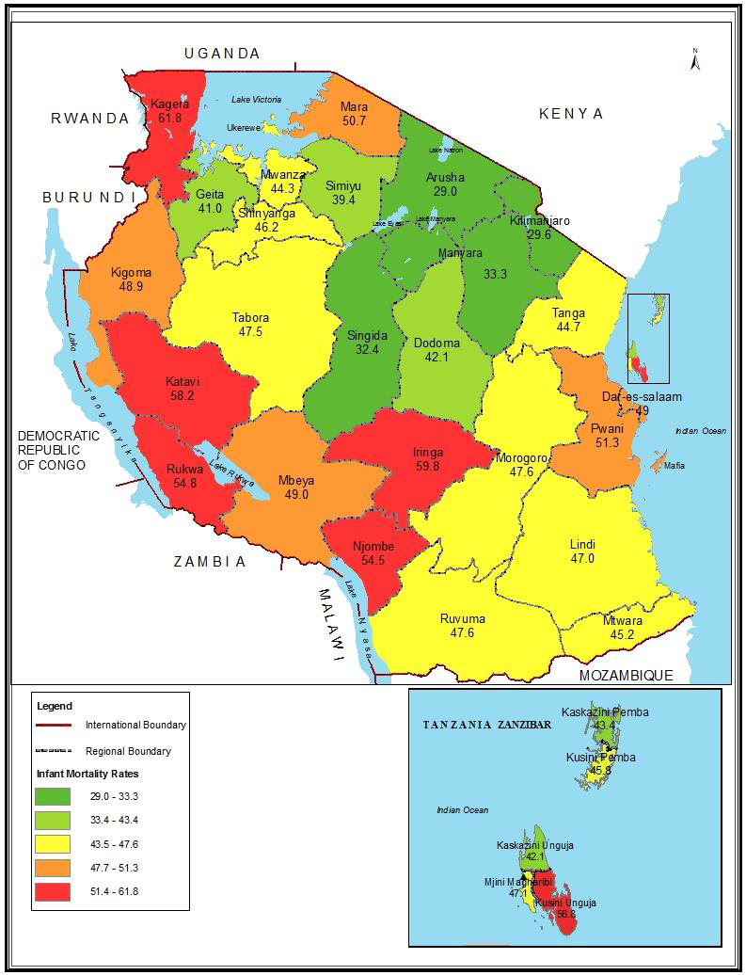
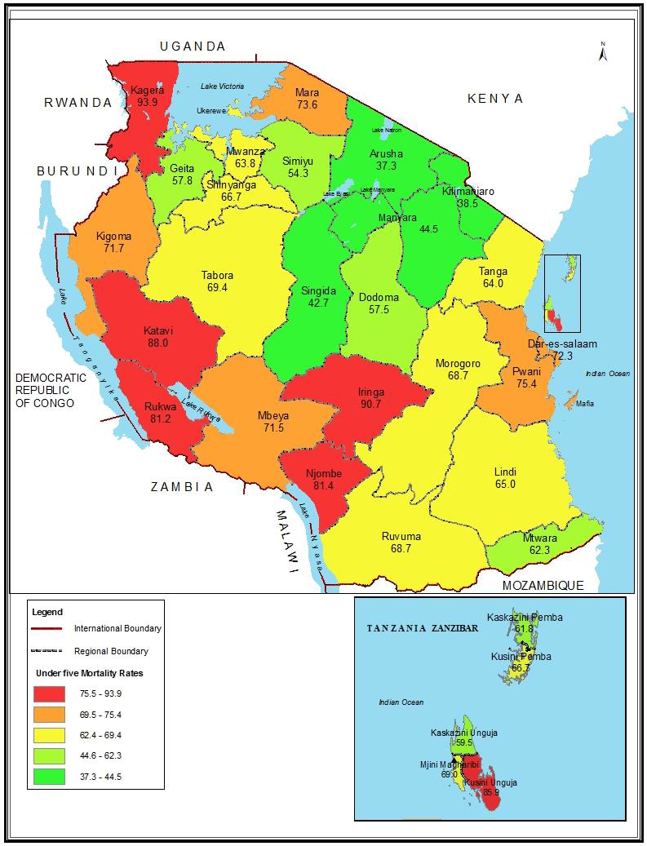
Infant Mortality Rate by Region, Tanzania 2012 Census
Under-Five Mortality Rate by Region: Tanzania 2012 Census
Source: Tanzania Census, 2012

Slide 14
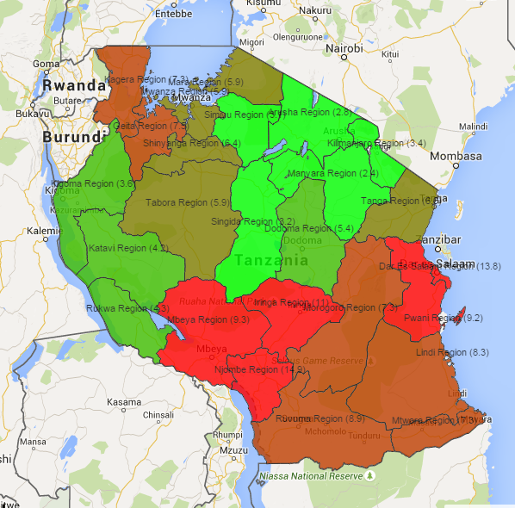
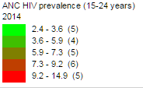
ANC HIV prevalence Among Pregnant Youth (15-24 years ) in 2014
National HIV prevalence rate among pregnant youth (15 – 24 years) is 6.8%
Leading region.
Njombe 14.9, Dar Es salaam 13.8, Iringa 11, Mbeya 9.3, Pwani 9.2
Lowest region Manyara 2.4, Arusha 2.8, Singida 3.2, Simiyu 3.4
Source: HMIS/DHIS 2014
Source: HMIS/DHIS 2014

Slide 15
Kagera 48
Mara 44
Mwanza 46
Malaria cases by Region as % of all OPD cases 2014
Arusha 4
Geita 48
Simiyu 33
Kigoma 43
Kilimanjaro 11
Shinynga 34
Manyara 28
Tabora 59
Singida 22
Dodom 18
Tanga 40
Katavi 37
Morgoro 49
Pwani 35
Rukwa 30
Mbeya 15
Iringa 16
DSM 15
>40
Lindi 41
30 - 40
Njombe 17
Ruvuma 34
20 -30
10 -20
Mtwara 39
< 10
Source: HMIS/DHIS 2014

Slide 16
Reported Causes of Death Year 2014
<5Yrs age year 2014
Proportional of death due to Malaria is dropping down but still the leading cause of death for under-five and five and above
Non – communicable diseases e.g. Hypertension, diabetes head injury, HIV/AIDS etc. coming up
Source: HMIS/DHIS 2014

Slide 17
Coverage of Interventions

Slide 18
Percent of expected pregnant women who delivered in health facility, 2014
Percentage of modern contraceptives users, years 2011 to 2014
Progress in key vaccination indicators, 2014
Delivery in Health facilities is still the challenge
Use of contraceptive is also still unsatisfactory
Good Coverage of Vaccinations of all vaccines
Source: HMIS/DHIS 2014

Slide 19
Status of Selected key Indicators Year 2014
% Trend of malaria in OPD
Trend of Malaria is significant dropping down
BEmONC coverage to dispensary and CEmONC to Health centres is very low
Source: HMIS/DHIS 2014

Slide 20
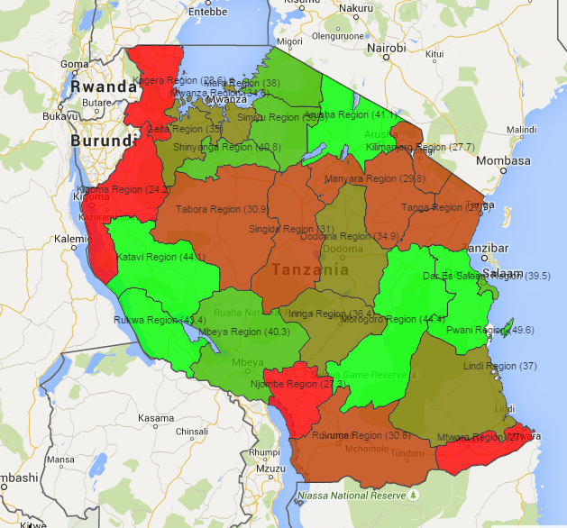
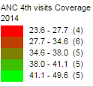
National ANC 4th visit Coverage year 2014
4th ANC Visit National 34.9%
High performing regions are Pwani 50, Katavi 44, Morogoro 44, Rukwa 43 and Arusha 42
Poor performing regions Kagera 23.6, Kigoma 24, Njombe 27 and Mtwara 27
Source: HMIS/DHIS 2014

Slide 21
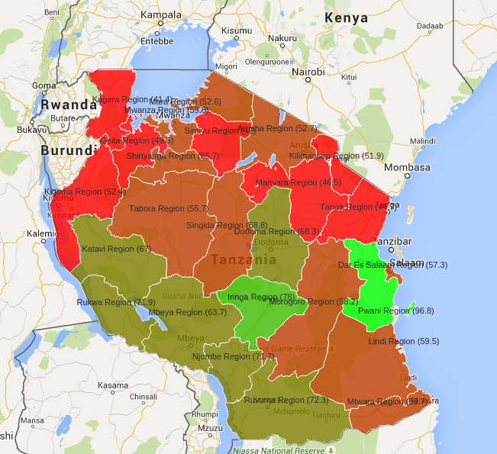
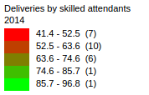
Delivery By Skilled Attendants in year 2014
% National Delivery by Skilled attendants = 57.5
Leading regions were Pwan 96, Morogoro 78.
Poor perfoming regions Kagera 41, Simiyu 42, Tanga 45, Marnyara 47, Geita 49
Poor recording in Dar es salaam
Source: HMIS/DHIS 2014

Slide 22
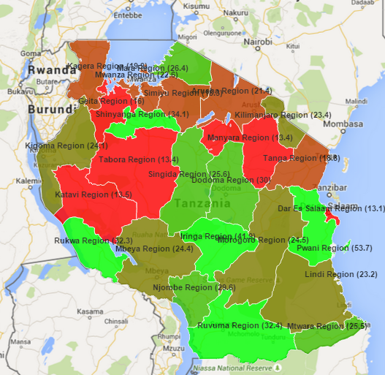
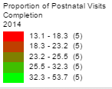
Postnatal Mother who did all Four Postnatal Visits
National Average 23.1
Add notes
Source: HMIS/DHIS 2014

Slide 23
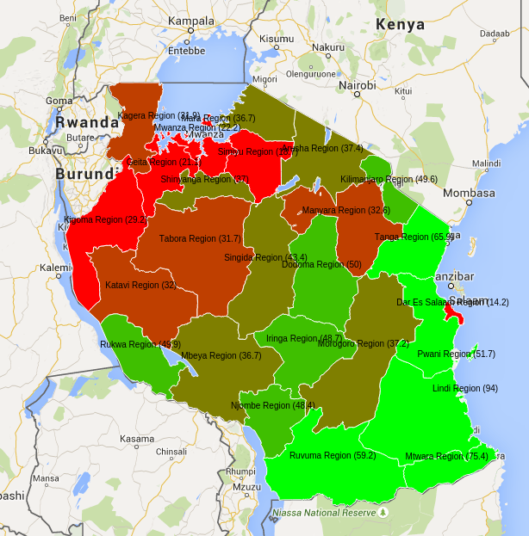
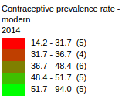
Contraceptive Prevalence Rate – Modern Methods - 2014
National CPR = 40%
High performing regions are Lindi 94, Mtwara 75, Tanga 65, Ruvuma and 59 Pwani 51.
Poor perfoming region are DSM 14, Simiyu 18, Geita 21, Mwanza 22, Kigoma 29,
Source: HMIS/DHIS 2014

Slide 25
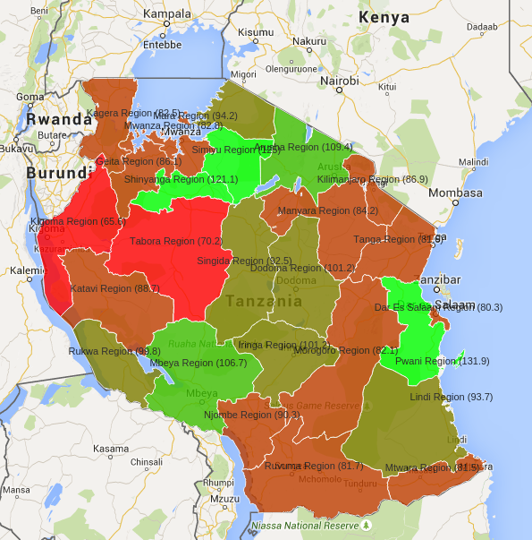
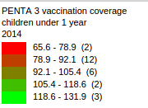
PENTA 3 Under 1 Age Coverage Year 2014
National Coverage
PENTA 3 = 90.4%
BCG = 132
Measles = 99.4
Polio Vaccines = 100
Source: HMIS/DHIS 2014

Slide 26
Summary of District Immunization Performance 2009 - 2014
Source: EPI/HMIS/DHIS 2014

Slide 27
National OPD and IPD Diagnosis in Year 2014
OPD Age Under Five
Source: HMIS/DHIS 2014

Slide 28
Per Capita Utilization year 2011 to 2014
Source: HMIS/DHIS 2014

Slide 29
Health Systems input and Output

Slide 30
Status of National HMIS/DHIS2 Reporting Rate Year 2014
RMNCH
Source: HMIS/DHIS 2014

Slide 31
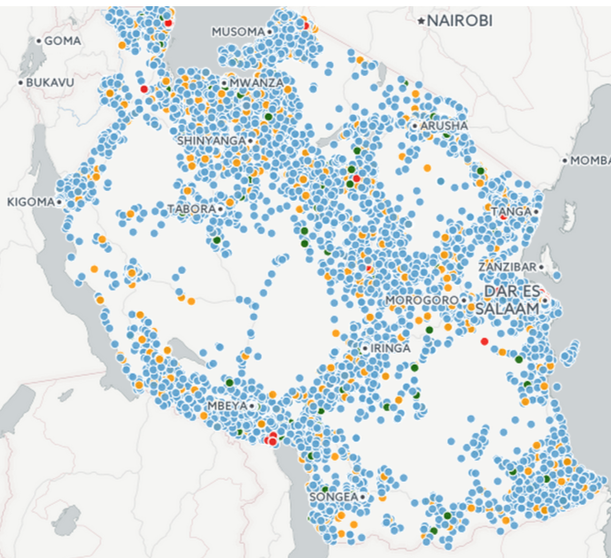
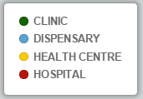
Mapping of Health Facilities in Main Tanzania Tanzania by Type as of
July Year 2015
Number Functioning Facilities
Hospital - 257
Health Centre - 718
Dispensary -6,143
Clinic – 136
Total -
Non Functioning Facilities
Under construction -536
Pending Construction completed - 72
Closed – 333
Temporary closed – 70
Total - 1,011
Posted on the eGov Website June 2015

Slide 32
Public Facilities Having the Entire Package of Tracer Medicine (10/10) for the Whole year 2014
Source: HMIS/DHIS 2014

Slide 33
Facility Density and Health Staff Per 10 000 population - 2014
3.7
National = 7.5
WHO recommend 28
Source: HMIS/DHIS2 Database 2014

Slide 34
Community Health Fund (CHF) coverage – HSSP III
Source: National Health Insurance (2014-2015)

Slide 35
CHF coverage by region, FY2014/15
Source: National Health Insurance 2015

Slide 36
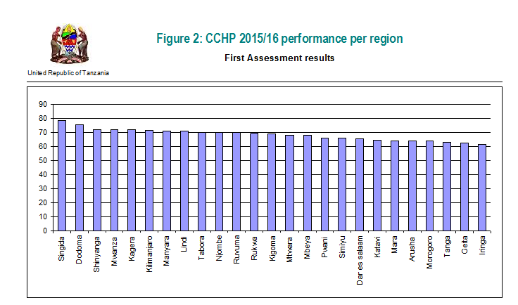
CCHP 2015/2015 Performance Per Region
Average % Score on First Assessment
Councils Assessed = 163
Recommended = 53%
Not Recommended = 47%
Councils not Assessed = 0
Source: CCHP 2015

Slide 37
Major Achievement
Good trend on implementation of HSSP III as large number of set indicators are likely to be achieved by end of implementation of HSSP III
Improved CCHP plan where majority of councils were recommended during the first round of evaluation.
DHIS2 and Plan-Rep have successfully been introduced and and well used to support CCHP.

Slide 38
Constraints
Some Indicators on RMHCH still show low performance coverage (e.g. 1st ANC visit before 12 weeks was 15%, ANC 4th visits 39.9%, received ITN voucher 29.8%, IPT2- 34.7%
Although trend show decrease of Malaria but still is the major OPD diagnosis and Caused of death for all ages
There is high increase of NCDs e.g. Hypertension 6.9%, Diabetes 3.2% as cause of death for five and above (Imeanza kutokea mwaka gani)
HIV reported 7.6% and injuries 2.8% as cause of death for five years and above
Data quality of HMIS/DHIS2 and Plan-Rep as source is still a challenge in some councils

Slide 39

Thank you

