Slide 1
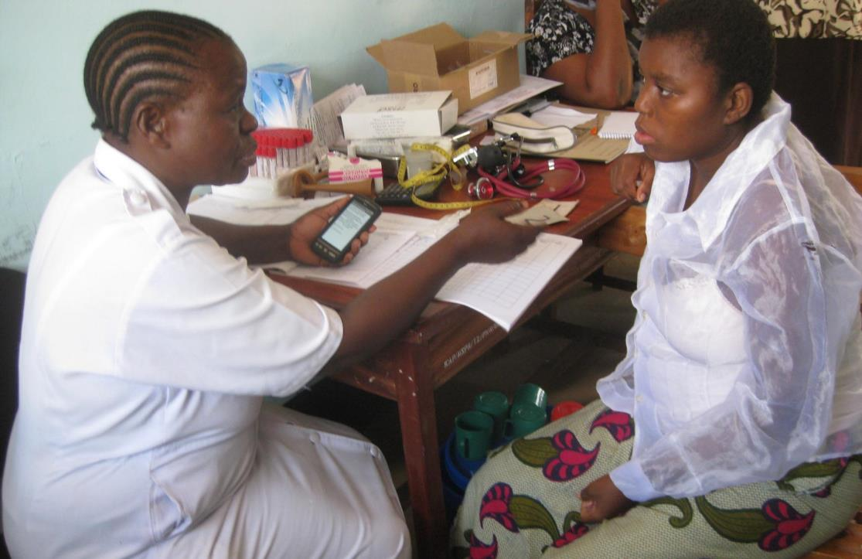
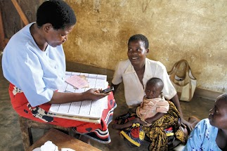
Mobile phones to improve quality at the point of care
Lucy Silas & Erica Layer
D-tree International
www.d-tree.org
@DtreeInt

Slide 2
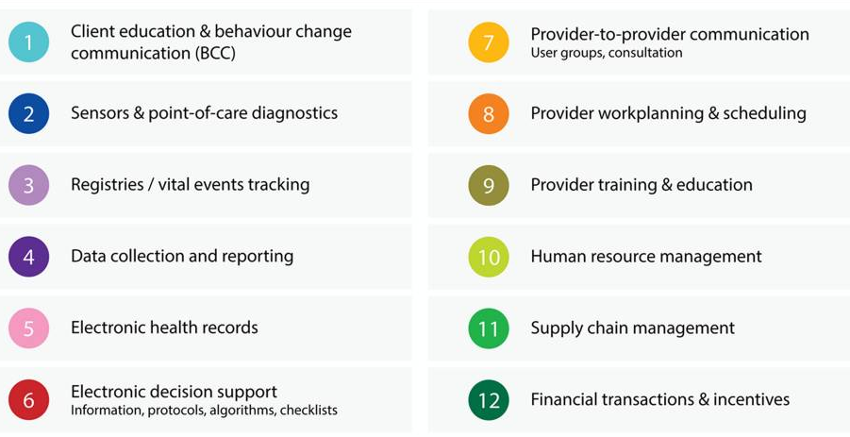
Types of mHealth interventions
Source:
mHealth innovations as health system strengthening tools: 12 common applications and a visual framework
Alain B Labrique, Lavanya Vasudevan, Erica Kochi, Robert Fabricant, Garrett Mehl. Glob Health Sci Pract August 1, 2013 vol. 1 no. 2 p. 160-171
Notes:
D-tree’s core is decision support but this to show different types of mhealth interentiosn but decision support includes a majority of these areas highlighted above

Slide 3
What D-tree does
Provide decision support tools for use by frontline health workers
  Design, Test and Deploy applications
  Partner with MOH and other health NGOs
Focus areas:
  Maternal and Child Health
  Chronic Disease
Notes:
Active projects in Benin, Malawi, Tanzania
Projects are DSS with or without a patient record
Health NGO
Partnership is key

Slide 4
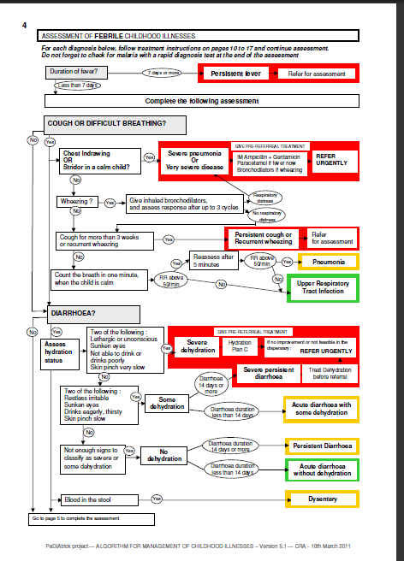
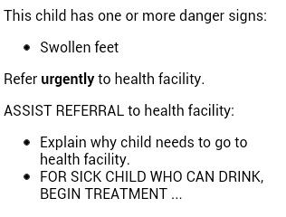
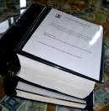
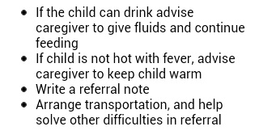
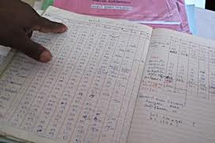
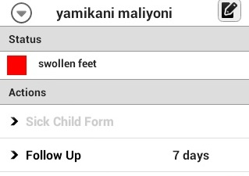
Notes:
protocols not always clear – guidelines may say something like check for problems and manage accordingly
How do we move from this to this?
Flow charts, massive guidelines, registers
To applications
Which can be used by health workers to see clients?

Slide 5
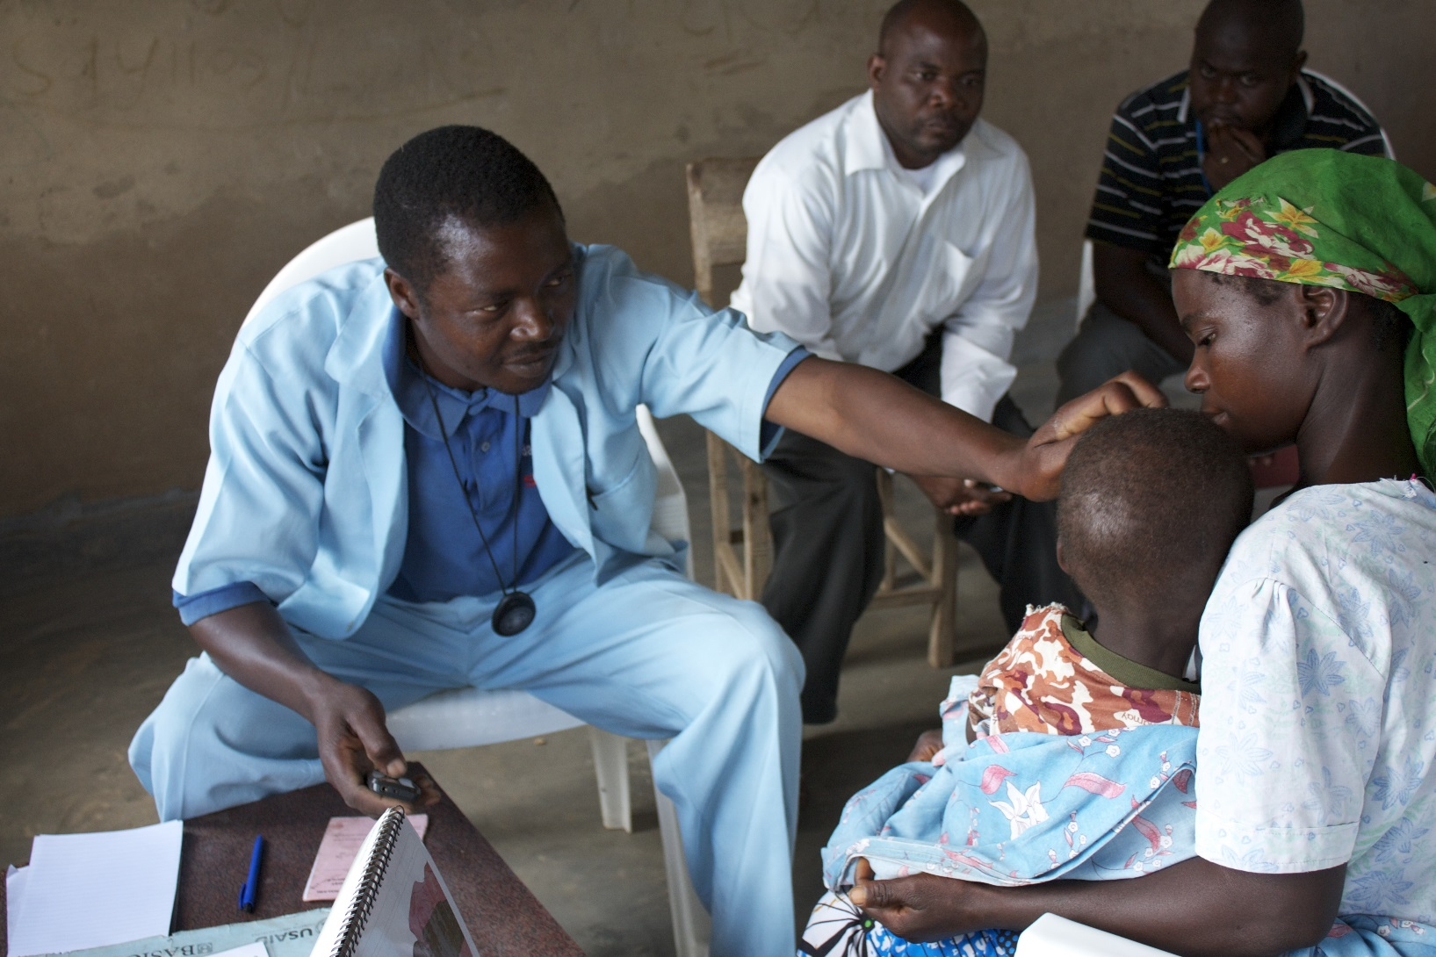
CCM Malawi

Slide 6
CCM in Malawi
Phase 1 – cIMCI tool on Nokia phones
Phase 2 – integrated CCM on Android
  Vaccinations
  Commodity tracking/reporting
  Monthly reports
  Dashboard
  Supervisory application
Phase 2a – modification to allow for RDTs
Phase 3 – integration with facility IMCI and CBMNH

Slide 7
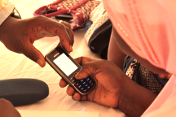
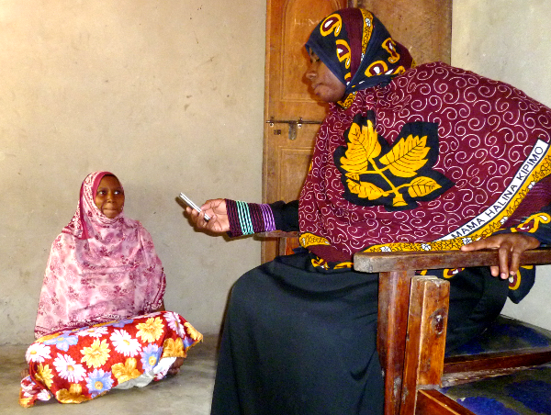
mHealth for Safer Deliveries
> 50% of births are at home
when transfer to hospital is needed there are 3 delays:
The decision to seek care
The transfer to a facility
Treatment at the facility
Notes:
Screening pregnant mothers to identify risks or danger signs
Establishing community-based referral systems to transport women in labor
Coordinating payment of transport to health facilities and hospitals using mobile banking
Following up with the family within 2-5 days after delivery to ensure a continuum of care, including post-partum and post-natal care

Slide 8
Results: Facility delivery
Over 78% facility delivery rate for 11,792 women who delivered (vs 30-40% DHS)
For those where last delivery place was home, now 66% gave birth in a facility
88% attended postnatal care within one week after birth (vs DHS 36% in 41 days)
Increased use of primary facilities, 34% compared to 4% (HMIS 2012)
Now in Phase III with SLAB includes a trial in mainland
Notes:
Now in 3rd phase Scale up to all of Zanzibar and a pilot approach in Mainland
Main focus on sustainability & government ownership
Saving Lives at Birth Transition to Scale

Slide 9
Maternal health
Mobile application followed guideline from MOH for antenatal care, prevention of mother-to-child transmission of HIV, postnatal care and postpartum family planning.
The aim of the project was to improve the quality of maternal health care by linking the facility and community through sharing information facilitated by the mobile application.
Enables patient tracking between CHW and facility currentl being used by EGPAF for PMTCT, Pathfinder for MMH
Early results show increase in danger signs detection and better data completion than paper forms
Notes:
Original funding from UNICEF to do ANC community/facility in Bagamoyo later with Jhpiego to add PNC and linkage of community to facility implemented Morogoro. WV adopted the community piece being implemented in Singida and kilidi
EGPAF added PMTCT Data generated using the mobile phone application is more complete than paper forms. No questions are skipped.
Danger signs are more frequently recognized resulting in higher number of referrals to higher level facility
Nurses report that while using the mobile tool takes more time they believe they are giving more thorough care.
Mothers report they have come to the clinic because they have heard about the phone and believe they will get better care.

Slide 10
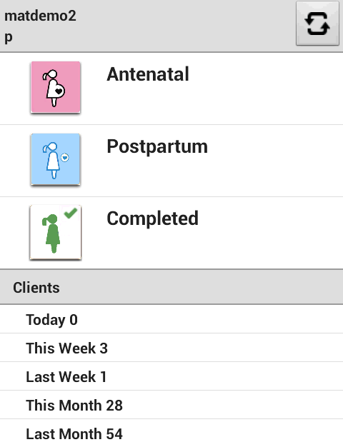
Provider feedback
1- Congratulations! You correctly screened 23 children today
2- You provided TT2 to 100% of eligible women today. You’re 70% of the way to earning a performance award for yourself and your facility!
Provider Data (2)

Slide 11
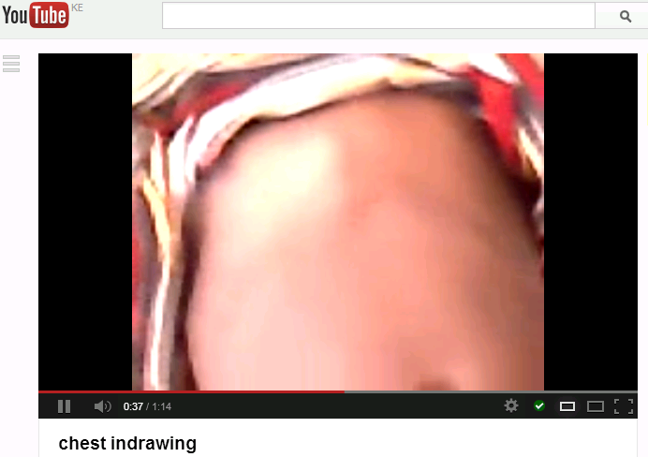
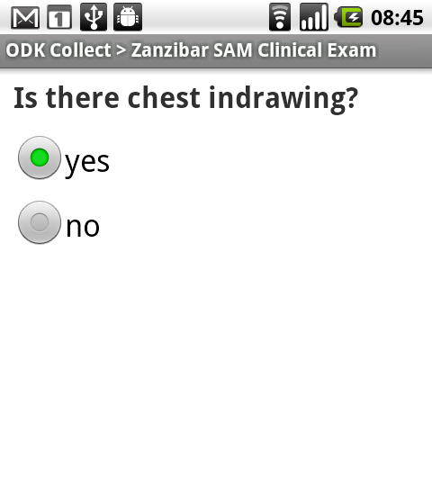

mHealth/mEducation
more

Slide 12
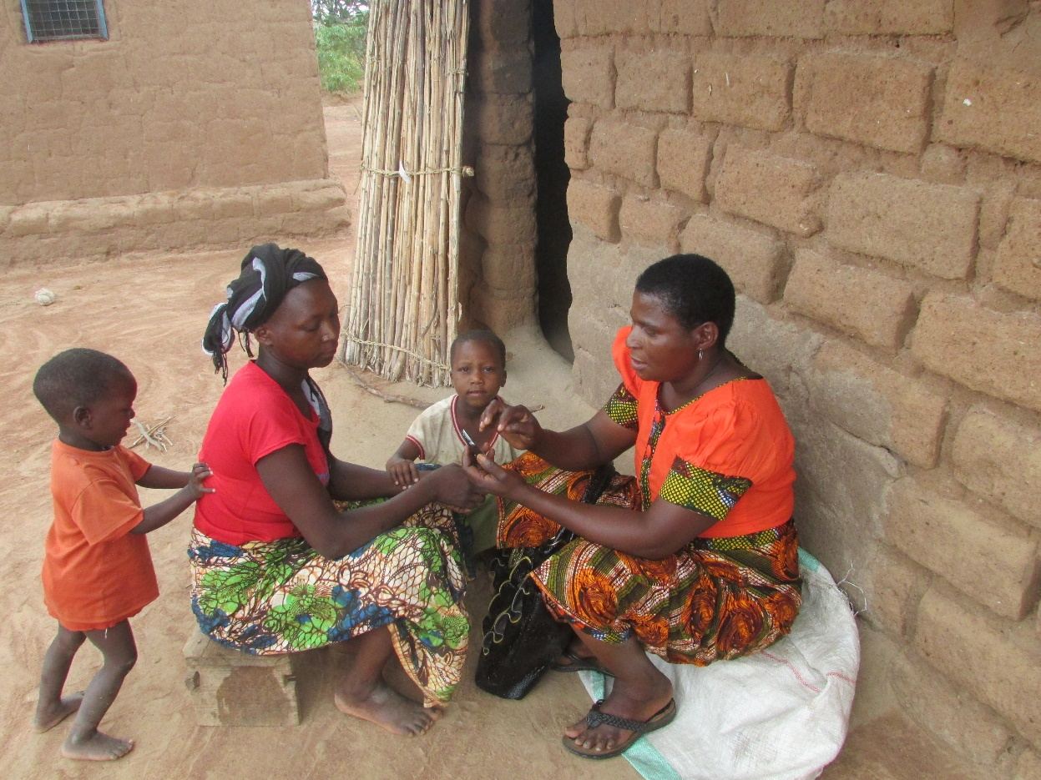
D-tree International:
Engaged mHealth
Notes:
Erica

Slide 13
Why engaged mHealth?
The problem:
Without systems of support and motivation, use of phones declines over time
Even with functioning dashboards, program managers and supervisors often do not engage with data for decision-making
What’s needed?
Motivated health workers who use the tools with every client encounter
Motivated managers who use the data for supervision & decision-making
Models for training, supervision & support at scale
Notes:
We know from our experience that it is not enough to simply provide training to health workers to use a mobile application. Often, they are eager at first and use the app, but then usage declines over time if there are not solid support and motivation systems in place. We need more than the “tools” to make an mHealth project sustainable.

Slide 14
What is engaged mHealth?
Involving Ministry of Health
Testing and refining with users
Effectively training health workers
Developing systems for scale
Motivating health workers
Developing dashboards & training stakeholders
Analyzing & using data

Slide 15
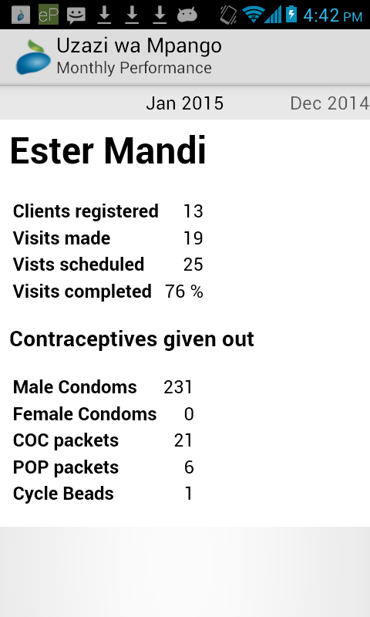
How we engage: Pay for performance
CHWs receive a base stipend every month (~USD 10)
Eligible to receive top-ups (~USD 2) for two performance targets:
  Target #1: Register 10 or more new clients
  Target #2: Follow up with 75% or more scheduled visits
Met performance target #1
View within CHW application
Met performance target #2
Notes:
Quickly explain the Family Planning program in Shinyanga (don’t need to go into details about work flow). Tell group you’ll use this project to provide some examples about how we engage – beyond the mobile app itself.

Slide 16
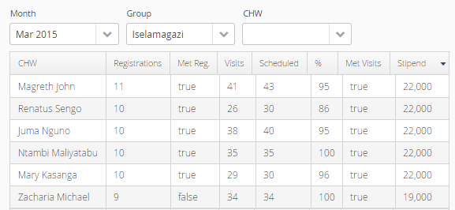
How we engage: Pay for performance
View on project dashboard
Performance target #1
Performance target #2
Notes:
The project team reviews this data on a weekly or bi-weekly basis and calls each CHW to discuss their performance, troubleshoot any issues and discuss a strategy to help the CHW meet her performance targets for the month.

Slide 17
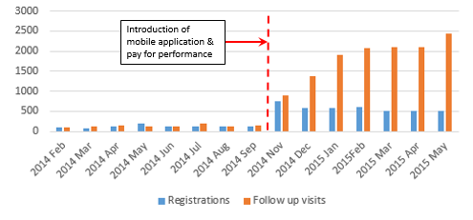
How we engage: Pay for performance
CHW performance before and after the introduction of the mobile FP application and pay for performance scheme in Shinyanga District Council, Tanzania. February 2014 – May 2015.
Notes:
Findings:
-522% increase in the number of monthly registrations (paper vs. mobile)
-More than a 12-fold increase in the number of follow-up visits comparing the average follow-up with paper vs. follow up visits in Feb & March 2015.

Slide 18
Innovative scale-up systems
CHW-Champion model:
  Identify, train & mentor CHW-Champions
  Invite CHW-Champions to assist during large trainings
  Develop Champion follow-up application
  Train CHW-Champions to use follow-up app to mentor newly trained CHWs
  Support Champions to provide mentorship & follow-up to newly trained CHWs
Results: CHWs who received follow-up from Champions had fewer errors and were able to use the mobile application independently more quickly than CHWs who received follow-up from the project team.
Notes:
Most common problems faced by CHWs: 1) Registering clients multiple times, 2) Not setting follow-up date for next visit, 3) Correctly following counseling using phone and cue cards, 4) Overdue follow-up visits

Slide 19
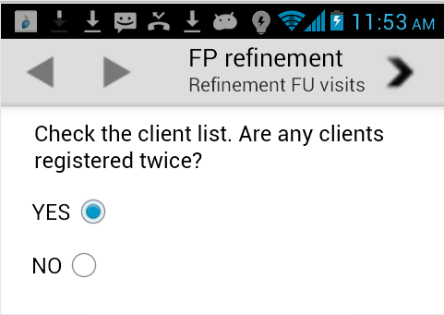
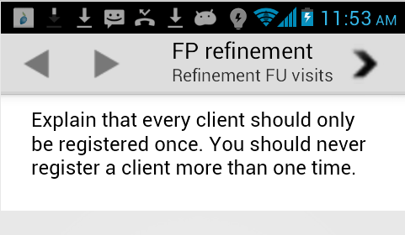
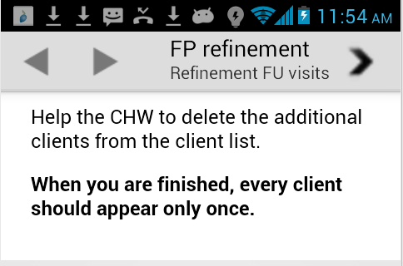
Champion follow-up app

Slide 20
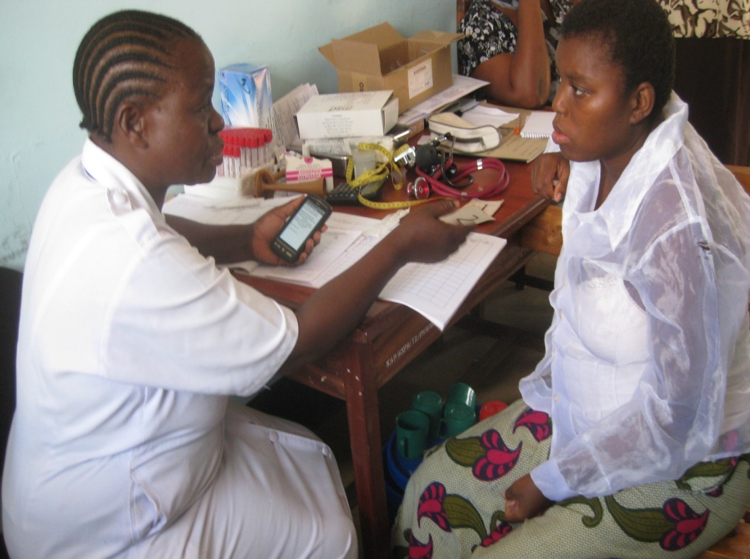
Thank you!
For more information:
Lucy Silas
lfulgence@d-tree.org
www.d-tree.org
@DtreeInt

