Slide 1
JICA’s Cooperation in Health Sector
2005 2006 2007 2008 2009 2010 2011 2012 2013 2014 2015 2016 2017
(2001～2007)
Strengthening RHMT/DHMT for District Health Services in Morogoro Region
(2008～2011)
Capacity Development for Regional Referral Health Management
(2011～2014)
Capacity Development in Regional Health Management Phase 2
(2015-2020)
Strengthening Hospital Management in Regional Referral Hospitals in Tanzania
(2008～2010)
Strengthening of Human Resource for Health Project (Advisor)
(2010～2014)
Strengthening Development of Human Resource for Health (5S-KAIZEN-TQM)
(2006～2010)
Project for Institutional Capacity Strengthening for HIV Prevention
(2010～2014)
Health Systems Strengthening for HIV and AIDS Services Project
(2003～2006)
Morogoro District HIV/AIDS Project (JICA Partnership Program)
(2004～2007)
Integrated Malaria Control Project
Notes:
WB・EU案件との連携
医療財政
財源：
公的負担
患者間接負担
患者自己負担（直接負担）
支出：
医療供給
医療圏での分担、リファラル
（医療施設の配置）→統廃合
上の一環として
第一次→ソフト＋ハード：各ドナー
第二次整備→過去無償、ソフト：他ドナー、Regionalization
第三次整備→過去無償、本案件
人材育成
PPP
各レベル機材整備→圧倒的に足りていない 他ドナー、過去無償、本案件
その他スライドに入れてないが
感染症対策（結核、HIV） グローバルファンド、WB
小児医療 SDC、UNICEF

Slide 2
Regional Referral Hospital Management Project (RRHMP)
Hisahiro Ishijima, MPH&TM, PhD
Chief Advisor-RRHMP
JICA-MoHCDGEC

Slide 3
Outline of RRHMP
Implementation period
May 2015 to May 2020 (total 60 months)
Phase 1: May 2015 – August 2016
Phase 2: October 2016 – May 2020
Target of the Project
Twenty-seven (27) Regional Referral Hospitals (RRHs) in Tanzania mainland
Implementers
JICA and MoHCDGEC
In collaboration with PO-RALG Division of Health, SW &Nutrition, RAS Office and RHMTs
National/Zonal Referral Hospitals
Universities & Training Institutions

Slide 4
Project goal and purpose
Overall Goal:
Quality of health service is improved at Regional Referral Hospitals (RRHs)
Project purpose:
Hospital management is improved at RRHs

Slide 5
OUTPUT 01
Strengthen
Basic Hospital Management
OUTPUT 06
Support BRN Commodity Management and sharing project experiences to other African countries
OUTPUT 02
Strengthen Planning and Reporting at RRH
6 expected outputs
from RRHMP
OUTPUT 05
Strengthen Governance at RRH
OUTPUT 03
Strengthen Monitoring and Evaluation at RRH
OUTPUT 04
Strengthen Resource management & Quality at RRH

Slide 6
PO-RALG
MOHCDGEC
Division Health, SW & Nut.
RHS section
DPP
Regional Health Coordination
National, Zonal Referral Hospitals
DCS
DHR
Universities &
Training institutions
RRHMP
DHQA
DPS
RAS Office
RHMT Office
27 RRHMTs
RRHABs

Slide 7
Project outline and process to achieve project purposes and goal
Overall Goal: Quality of health service is improved at Regional Referral Hospitals (RRHs)
Project purpose: Hospital management is improved at RRHs
Institutionalize the HMT training
Regular production and use of CHOP
Useful for evidence based CHOP development
Health resources are well managed, and reduce wastes
Establish functional HAB at all RRHs
Continuation of study tours
Continuation of PRM
Phase 2
Oct.2016
– May .2020
Introduction of HRHIS into RRHs
Training on M&E to all RRHs
Conduct hospital management training for all RRHs
Conduct HAB orientation training for all regions
Continuation of NQIF support
Continuation of KAIZEN training and CV
Conduct training of CHOP for all RRHs
Develop externals tools
Continuation of BRN training for 4 regions
Pilot in 3 RRHs
Pilot in 3 RRHs
Pilot in 3 RRHs
Train 27 RRHs
Pilot in 3 RRHs
Conduct BRN training for 1 region
Phase 1
May 2015
– Aug.2016
Develop training guidelines and teaching materials
Revise CHOP guideline
Develop Internal SS
Facilitator’s training on KAIZEN
Develop guidelines for establishment and operating of HAB
Participating of NQIF
Revise KAIZEN training materials
Receiving study tours
OUTPUT 1
Basic management capacity of HMTs is improved
OUTPUT 2
Planning and reporting capacity of RRHs is improved
OUTPUT 3
Monitoring and Evaluation of RRHs is strengthened
OUTPUT 4
Resource management and QI activities are strengthened through KAIZEN approach
OUTPUT 5
Governance of RRHs is strengthened
OUTPUT 6
Tanzania's experience on hospital management and QI are shared

Slide 8
Findings from Baseline survey at RRHs
No standardized RRH’s organogram. Every hospital has there own structure
More than 50% of RRHs staff do not receive training on key management functions
Majority of RRHs (48%) operate in debits balances thus making MSD to supply drugs without having money at their respective accounts.
The range of money that RRHs owe MSD is between TZS 1,069,319 (Coast) and 346,355,757 (Kigoma).

Slide 9
Findings from Baseline survey at RRHs
Mzumbe, MUHAS, St. John’s, University of Dodoma, St. Augustine, CHEDA run courses related with health system management. However, no courses focuses on hospital management at regional level
Situation of developing hospital operation plan were studied during the baseline survey
12/27 RRHs did not develop and submit CHOP in 2015
Previous year experiences and expenditures are not properly applied to develop CHOP (no evidence based)
Many RRHs are complained about complication of CHOP guideline
*CHOP: Comprehensive Hospital Operational Plan (for RRHs)

Slide 10
Findings from Baseline survey at RRHs
Situation of hospital performance assessment (HPA) activities were studied during the baseline survey
Existence of various HPA tools
IHI, Pharmaccess, Evaplan/GIZ, Star Rating, NHIF accreditation tool etc.
No HPA tool particularly for RRHs
No internal monitoring tool to monitor the progress of CHOP implementation for RRHs
Situation of Hospital Advisory Board (HAB) is studied during the baseline survey
14/27 RRHs have not established HAB yet
Newly established 4 regions (Geita, Katavi, Njombe, Shimyu)’s RRHs are still operating as CHSB
There is no clear and detailed guideline for HAB operation

Slide 11
OUTPUT 1: Strengthen Basic Hospital Management
Main activities
Development of Hospital Management Training materials
Basic Hospital Management Training for RRHMT
Applied Hospital Management Training for RRHMT
Progress of the activities
Training materials for Basic Hospital Management is developed
Training materials for applied Hospital Management is developed (Finance management, NHIF and CHOP)
Facilitator Training was conducted
Pilot training for 3 RRHs was conducted

Slide 12
OUTPUT 2: Strengthen Planning and Reporting at RRH
Main activities
Development of Guideline, Planning and Reporting Formats for Comprehensive Hospital Operational Plan (CHOP)
Training on CHOP for RRHMT
Introduce Human Resource for Health Information System (HRHIS) into RRHs
Progress of the activities
The following documents were developed and waiting comments from different stakeholders for finalization
CHOP guideline
CHOP format
CHOP Quarterly Report format

Slide 13
OUTPUT 3: Strengthen Monitoring and Evaluation at RRH
Main activities
Development of Internal Supportive Supervision (ISS) guideline and ISS tools
Development of External Hospital Performance Assessment (HPAT) guideline and ISS tools
Training on ISS and HPAT
Progress of the activities
ISS pilot test was conducted at Dodoma and Morogoro RRHs
Comments were reflected in the guideline and tools for finalization

Slide 14
OUTPUT 4: Strengthen Resource management & Quality at RRH
Main activities
Strengthen health resource management through 5S-KAIZEN-TQM approach
Progress of the activities
Conduct KAIZEN TOT for all 27 RRHs
Consultation visit is on going to provide technical support on KAIZEN activities
*5S: a principle to improve working environment with 5 steps of Sort, Set, Shine, Standardize and Sustain.
*KAIZEN: “Improve” in Japanese, started at Toyota to improve productivity, quality assurance and safety in the working environment through a participatory problem solving process conducted by a work unit via “teamwork.”
The practices at the hospitals focuses on improving health service quality such as reduction of waiting time, reduction of occurrences of phlebitis from intravenous cannulation, improvement of insurance refunds from NHIF etc.

Slide 15
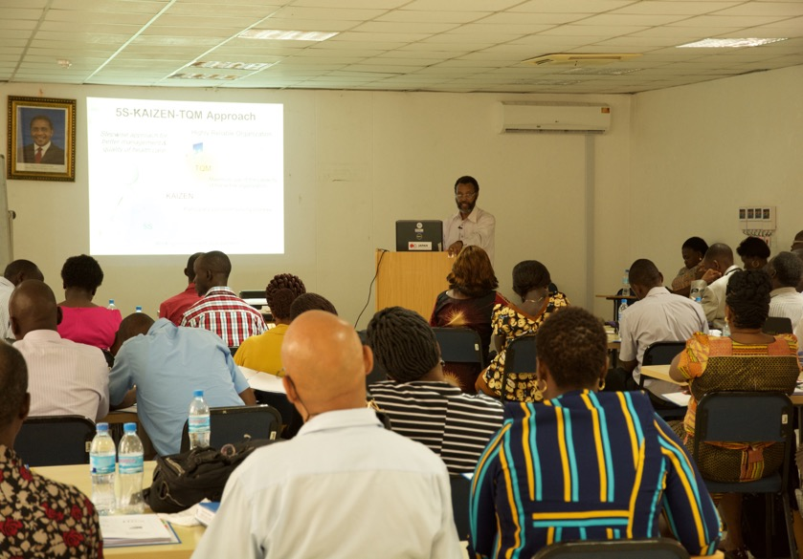
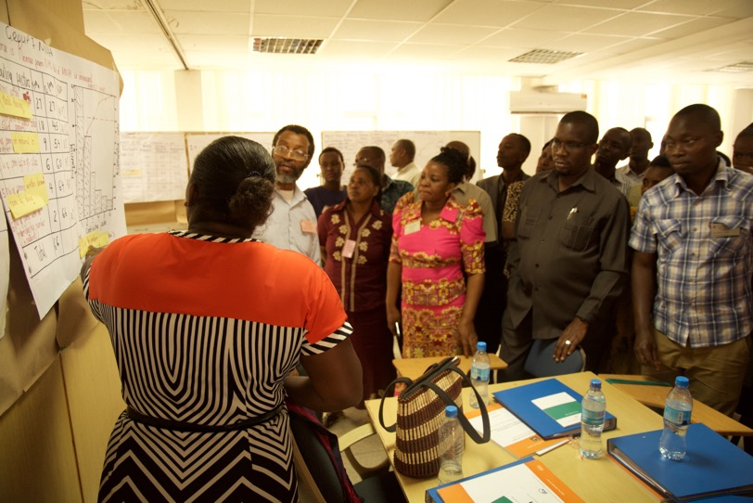

Slide 16
OUTPUT 5: Strengthen Governance at RRH
Main activities
Conduct situation analysis of Regional Referral Hospital Advisory Board (RRHAB)
Develop RRHAB orientation guideline
Pilot RRHAB orientation training
Training all 27 RRHs on RRHAB orientation
Progress of the activities
RRHAB orientation guideline is developed
RRHAB orientation training was pilot at 3 RRHs

Slide 17
OUTPUT 6: Support BRN Commodity Management and sharing project experiences to other African countries
Main activities
Receiving study tours on 5S-KAIZEN-TQM approaches
Support BRN commodity management training at 5 regions
Progress of the activities
Received the study tour from Bangladesh MoH
Received the study tour from Malawi MoH
BRN commodity management training materials were developed
Conducted Facilitators Training for BRN commodity management to produce 18 National facilitators

Slide 18
Thank you!

