Slide 1
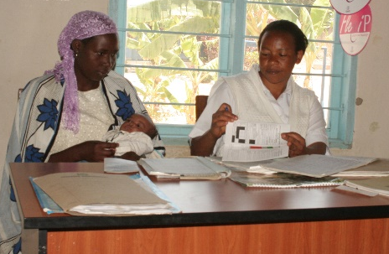
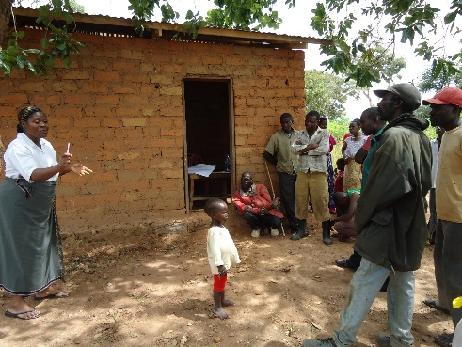
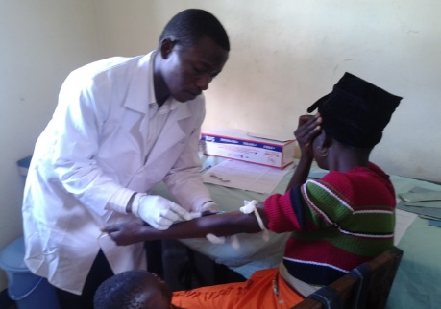
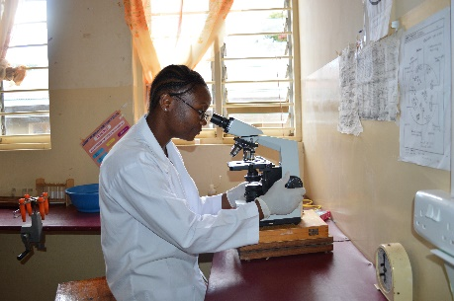
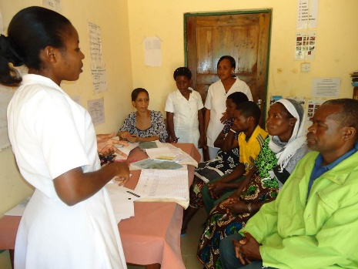
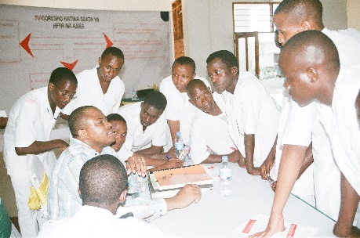
Innovatively reaching the underserved!
Presented at the DPG Health Meeting by
Dr. Ellen Mkondya-Senkoro, CEO- BMAF
4th March 2015

Slide 2
Outline
Who we are
Our Key Result Areas
Our milestones contributing to national goals
Institutional growth and sustainability
Challenges ( Opportunities for Development)
Programmatic
Institutionally
Way Forward and Conclusion

Slide 3
Who we are
Trust registered in 2006, founded by the Former President to complement the Government efforts in the fight against HIV/AIDS
Vision - To be a hub in innovations of Health Service Delivery in Tanzania
Mission - To facilitate the delivery of responsive health services, including HIV and AIDS, particularly in underserved areas through innovations in health systems
Governance body, Management and Staff : HQ offices and 3 Field offices ( Mtwara, Iringa and Mwanza)

Slide 4
Key Result Areas
Its 2nd Strategic Plan of 5 years from 2013- 2018:
KRA 1: Reinforced HIV and AIDS, MNH and other health conditions
KRA 2: Evidence Based Solutions on Human Resource for Health
KRA 3: Robust Management of IEC
KRA 4: Sustainable Business model of BMAF
KRA 5: BMAF Operational systems and Technical Leadership

Slide 5
Key Result Areas
Realization of BMAF’s Strategic Plan is through “Projects”
Theme | Project Name | Duration/ Coverage | Funding agency | Budget
HIV/AIDS and RMNH | 1.Mkapa Fellows Programme I | 2005- 2010 33 districts | Norway Govt Clinton Health Access Initiative | US $ 2 m
 | 2.Mkapa Fellows Programme II | 2013- 2017 15 districts | Irish Aid, > 50 Corporates incl. Acasia (ABG), Govt/LGAs | US $ 10m
 | 3. Emergency Hiring Programme | 2007 – 2010 19 districts | Global Fund to AIDS, TB & Malaria – Round 3 and 4 | US $ 7m
 | 4. Saving Lives of Mothers & Newborns | 2010- 2012 2 districts ( Singida) | World Lung Foundation | US $ 300,000
Human Resources for Health | 1. Tanzania Human Resource Capacity Project | 2009 – 2013 54 districts | USAID | US $ 4.9m
 | 2. Health Systems Strengthening Project | 2011- 2016 70 districts | Global Fund to AIDS, TB & Malaria - Round 9 | US $ 50m
 | 3. Advocacy on HRH Project | 2015 - 2017 Central level | USAID , Irish Aid | US $ 390,767

Slide 6
Our milestones contributing to national goals
Reduction of National HRH shortage from 68% to 48% and improved HRH environment:
1008 Students grants for Allied Health Training
More than 1061 Health workers recruited
84% retained in Public service employment system
Trained, coached and mentioned 1431 managers in leadership and effective planning and management of Human Resource for Health.
Enhanced HRH retention through construction of 310 rural staff houses in 31 rural districts eg. reduced regional staff housing gap by 42% ( Singida) 20% ( Mtwara) and 32% ( Rukwa)

Slide 7
Our milestones contributing to national goals
Enhanced HRH Policy Environment:
HRH Technical Working Group
First National HRH Conference in 2013
Scale up of Human Capital Management Information Systems
The National Incentive and Pay Policy (2011)
National HRH Staffing level revision of 1999 ( edition of 2013)
National Orientation package for newly recruited health workers
Revision of CCHP guideline in 2011- Priority area on HRH reinforced

Slide 8
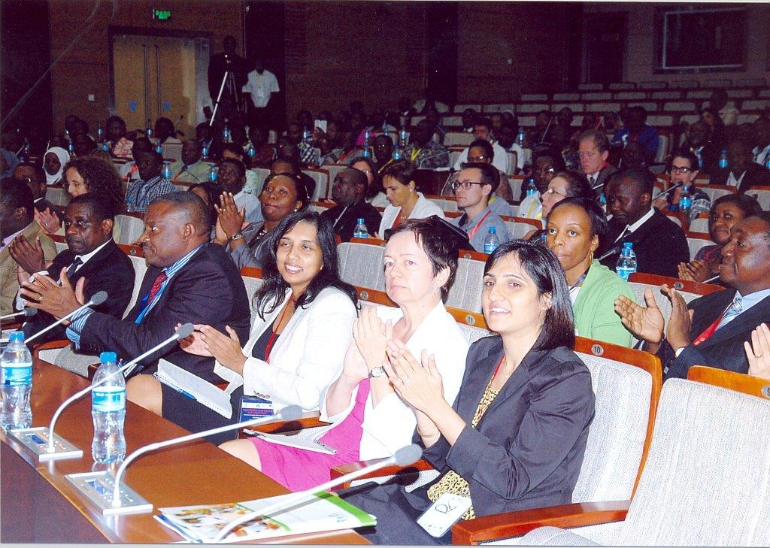
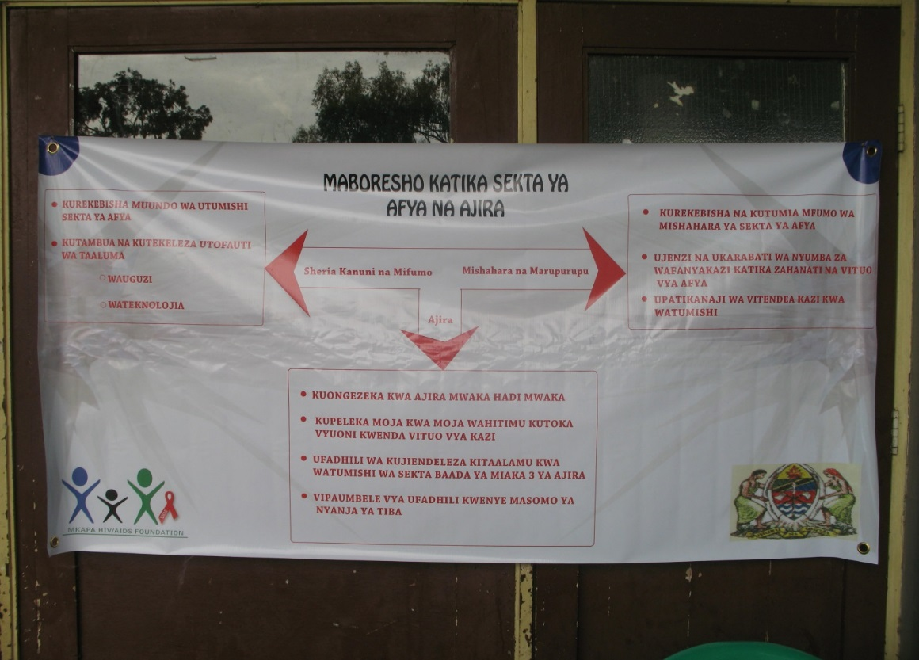
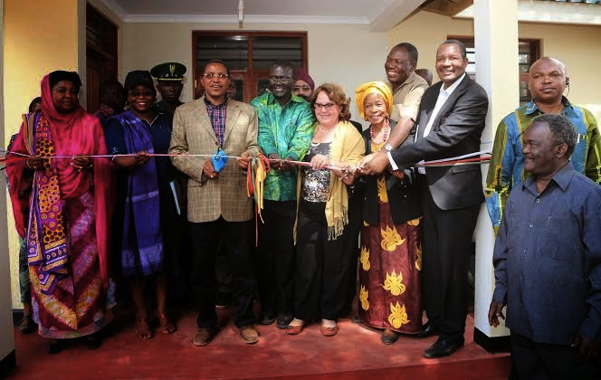
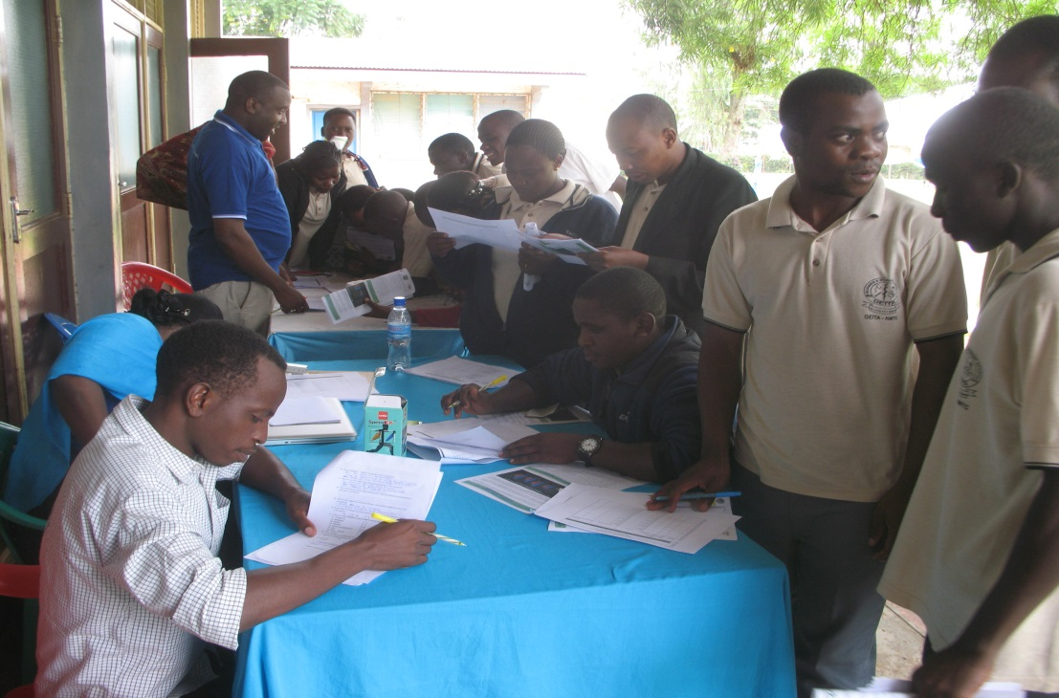

Slide 9
Our milestones contributing to national goals
Increased national enrollment of HIV clients
Trained, coached and mentored more than 700 HWs on HIV/AIDS leading to 5 fold increase in clients enrolment and put on HIV therapy within the districts of intervention
Contributing to the One Plan target of increasing CEmONC services (50% of health centres with CEmONC by 2015):
Reinforced MNH care through:
Capacity development on CEmONC to 35 health professionals with aim of saving lives of pregnant women
Construction and renovation of 9 theatres at health centre levels

Slide 10
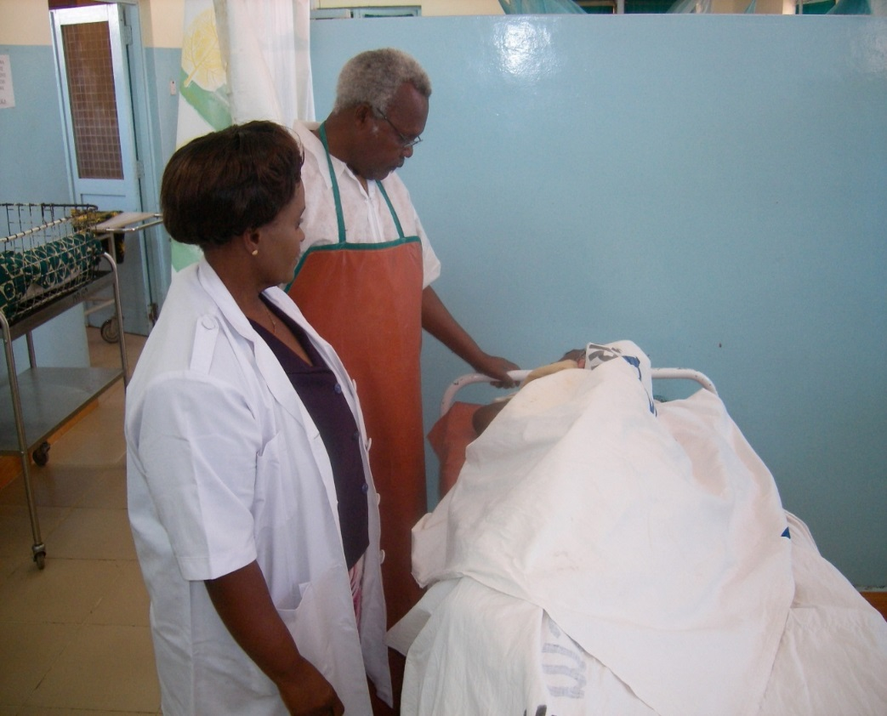
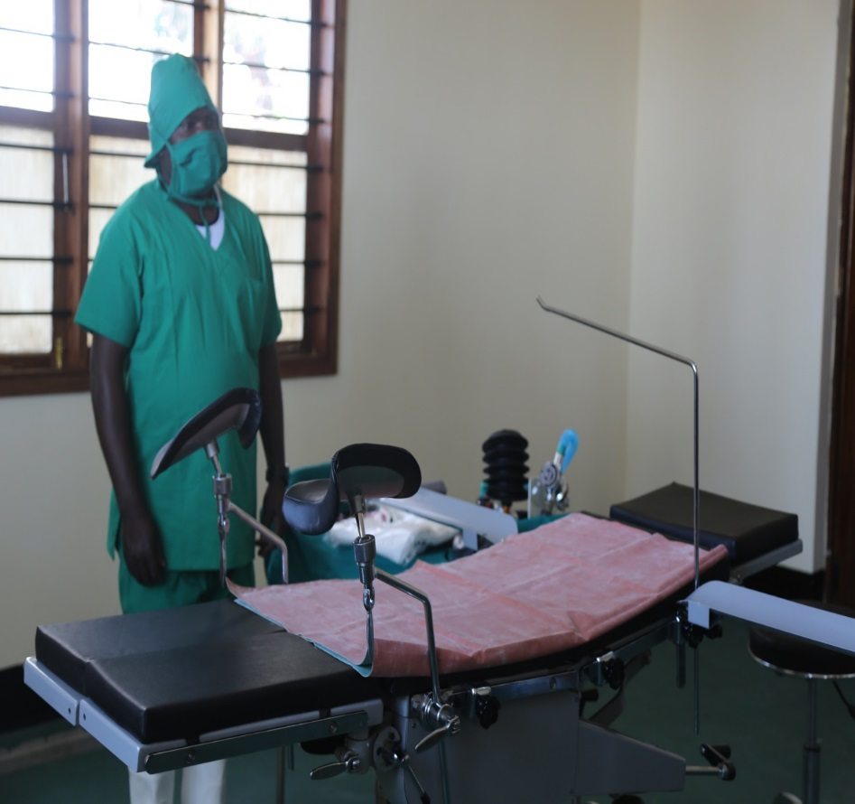
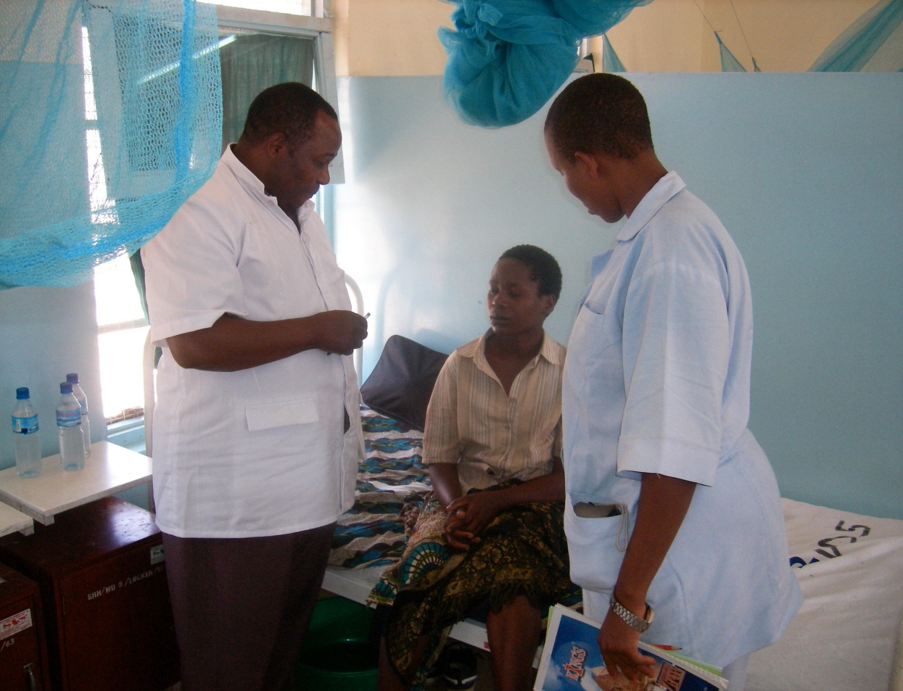

Slide 11
Mkapa Fellows Programme II
.
5 years : 2013 – 2017 to reach 15 districts from Rukwa, Simiyu, Shinyanga, Kagera and ZNZ
Goal: Contribute to the improved health systems for addressing HIV/AIDS and Maternal Newborn health challenges in 15 districts of Tanzania by Dec 2017
Objectives:
i) Scale up the CTC, PMTCT and CEmOC at Primary Health Care level
ii) Improve Human Resource Management
Selection critieria : Prevalence of HIV, HRH shortage, Poverty Index, Maternal deaths, Presence/absence of Partners

Slide 13
Institutional growth and sustainability
Costed 5 years Strategic Plan into a Business Plan ( July 2013 – June 2018):
Funding requirement: Tshs 138bn ( inclusive of existing ongoing initiatives/projects)
Funding gap Tshs 84bn ( 60% of the 5 years plan) – this includes the Mkapa Fellows Programme II funding gap.
The Funding gap is intended to:
Benefit at least 2.4 people with better health services
Strengthen health service delivery on HIV and AIDS and MNCH
Reinforce Management , Policy and Advocacy on HRH
Support BMAF sustainable plans

Slide 14
Institutional growth and sustainability
Business development strategy provides various modalities for resource mobilization for the Business Plan:
Grants : solicited and unsolicited
Corporates ( fundraising): as CSR, bilateral agreement through development fund
Consultancy: provision of consultancy services by BMAF
Investment: financials including Endowment Fund and non-financial /property ( managed by a Special Purpose Vehicle)
Government
An average income of Tshs. 10bn per annum with an average expenditure against budget- 65%
Consecutively “clean’ audit reports since inception
Staffing 40 ( 70% versus the required as per 2014 organizational structure)

Slide 15
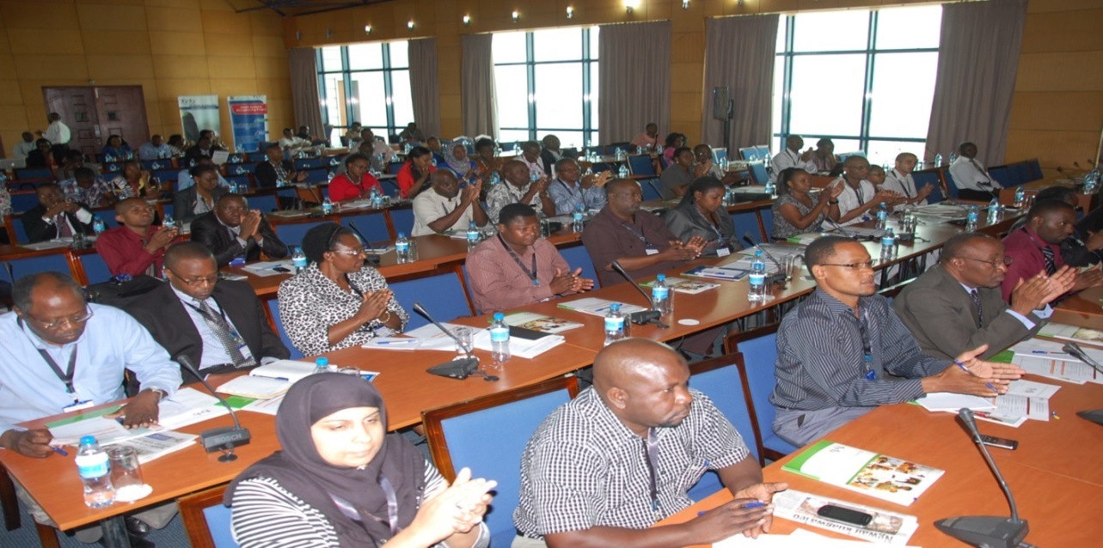
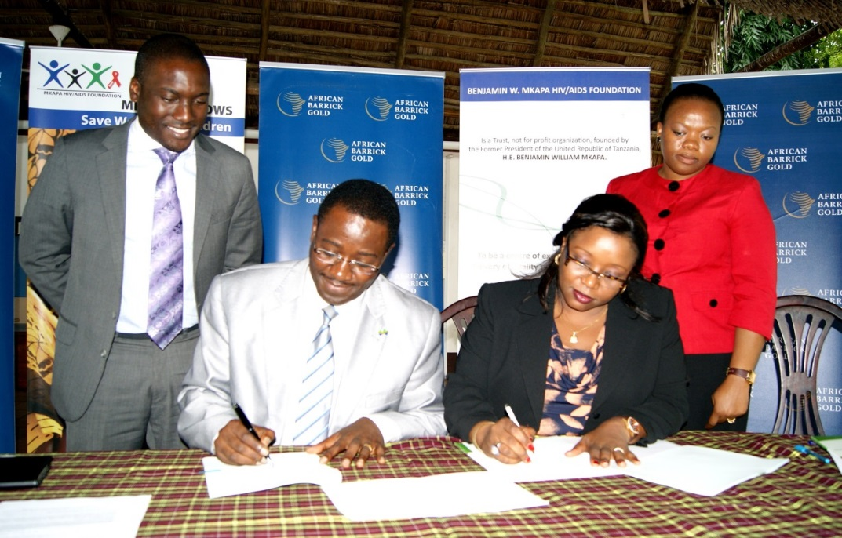
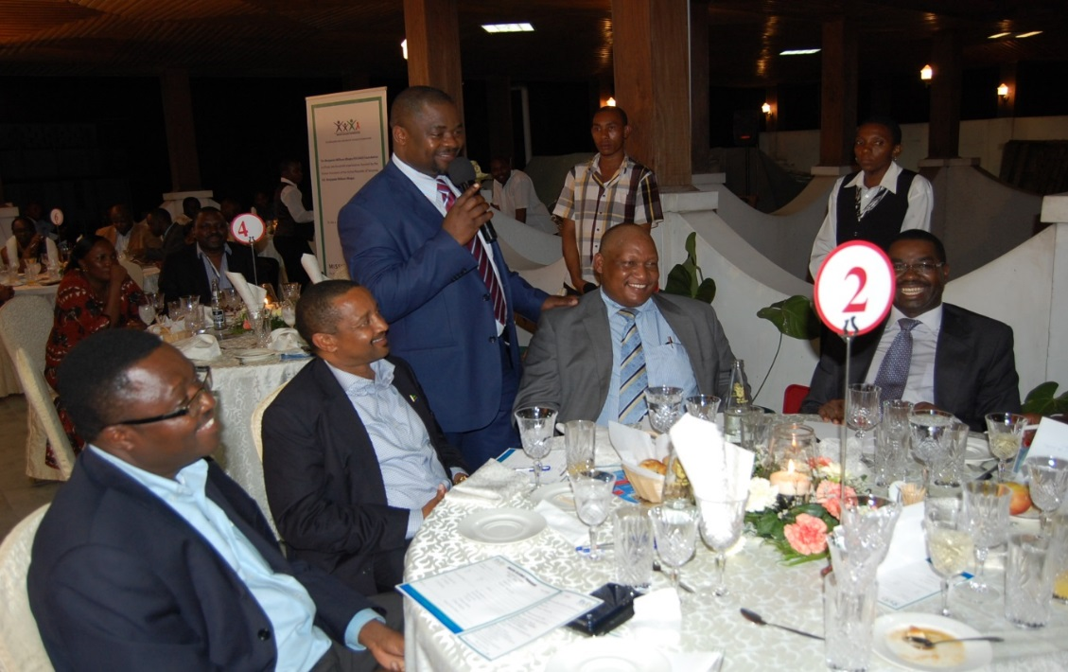

Slide 16
Challenges ( Opportunities for development)
Institutional ( BMAF)
Project focused funding versus multi-year funding
Initiation of BMAF Basket fund
BMAF wide spread geographical coverage and being an implementing agency versus operating as an ideal Foundation
Regionalization of BMAF program ( 7 Regions of Iringa, Njombe, Simiyu, Rukwa,Mtwara, Lindi and Shinyanga)
Gradual initiation of sub-granting to other implementers (local NGOs including Professional Associations, RHMT, CHMT, Zonal Resource Centres)

Slide 17
Challenges ( Opportunities for development)
Programmatic
Coordination challenges ( Inter-ministerial and Intra-ministerial) for both addressing the HRH and service delivery, particularly RMNCH.
Big Result Now concept is expected to address this challenge
Fragmented and Vertical support by donors on health programs, including competing environment for international and local Non- State Actors (NSAs)
Need for deliberate coordination by the Donors
Affirmative commitment by the Govt and DPs to support complementary efforts of the local NSAs

Slide 18
Challenges ( Opportunities for development)
Programmatic
Limited health sector funding creates steep competition for resources ( NSAs versus Government)
Public- Private/NSA partnership concept to be cross cutting approach in HSSP IV including BRN
Need for comprehensive intervention to make CEmONC functional such as Blood transfusion, nurse anaesthesia course, availability of skilled personnel, maintenance systems, CHWs

Slide 19
BRN and BMAF INITIATIVES
 | Regions | BRN |  |  | BMAF
 |  | HRH | RMNCH |  | 7 Regionalized Area | Mkapa Fellows Programme | Health Systems Project
1 | Kigoma | X | X |  |  |  | X
2 | Geita | X | X |  |  |  | X
3 | Mwanza |  | X |  |  |  | X
4 | Mara |  | X |  |  |  | X
5 | Simiyu | X | X |  | X | X | X
6 | Shinyanga | X |  |  | X | X | X
7 | Kagera | X |  |  |  | X ( Biharamulo) | X
8 | Rukwa | X |  |  | X | X (Sumbawanga R, Nkasi & Kalambo) | X
9 | Katavi | X |  |  |  |  | X
10 | Iringa |  |  |  | X |  | X
11 | Tabora | X |  |  |  |  | X
12 | Singida | X |  |  |  |  | X
13 | Njombe |  |  |  | X |  | X
14 | Mtwara |  |  |  | X |  | X
15 | Lindi |  |  |  | X |  | X
16 | ZNZ & Pemba |  |  |  |  | X

Slide 20
Way Forward and Conclusion
Diversify funding base for the Organization, including welcoming multi year funding partners ( BMAF Annual Donors meeting)
As BMAF transitions to operating as an ideal Foundation it aims to create “catalytic” and “innovative” programs in context of changing environment
Capitalize on PPP in implementing BMAF Strategic Plan, the HSSPIV, National plans on HRH, One Plan on RMNCH, BRN etc.
Institutionalize BMAF lessons learnt and interventions into the Government systems ( for sustainability)

Slide 21
Way Forward and Conclusion
What is unique of BMAF:
Virtuously indigenous institution
Trusted partner of the Government of Tanzania
Its Strategic Plan is in alignment to the national development strategies
Good model for Public-Non State Actors-Private sector partnership
Focused on evidence based and replicable interventions at the Central (upstream) and Local ( downstream) levels
Sustainability streamlined in its Programmes and Institutionally
Lets join our efforts in realizing better health outcomes among Tanzanians, particularly the underserved rural communities.

Slide 22
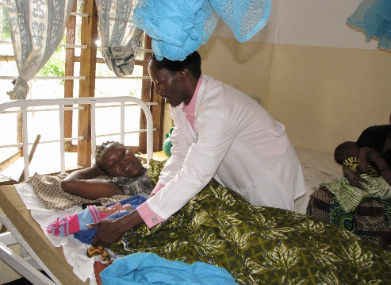
Voices from the Field
“I gave birth at home because I was not sure to get service at the facility as there used to be only one Nurse. Unfortunately I lost two babies, but since last year we have seen more Nurses have come to work at the facility and I was able to get good services and deliver this baby in safe hands” …… Agnes Willson 21, Kakonko village , Nyantakara in Biharamulo
.

Slide 23
Thank you for your attention

