Slide 1
DPG Health Meeting April 6, 2016

Slide 2
PS3 Purpose
Provide technical assistance to the Government of Tanzania to strengthen public sector systems in support of the delivery, quality, and use of public services, particularly for underserved populations.

Slide 3
PS3 Basic Information
Prime contractor: Abt Associates
Timeframe: 5 years from July 2015 to July 2020
Funding: $62 million for technical assistance (no direct financial support)
Consortium:
Benjamin W Mkapa Foundation (BMAF)
Local Government Training Institute (LGTI)
Tanzania Mentor’s Association (TMA)
University of Dar es Salaam (UDSM)
Broad Branch Associates
IntraHealth
Urban Institute

Slide 4
PS3 Implementation
National level
Ongoing engagement and support for policy dialogue and systems strengthening with all relevant Ministries, Departments, Agencies
Across sectors: support PO-RALG, POPSM, and MOF
Within sectors: prioritize MOHSW/health sector but engage in many sectors

Slide 5
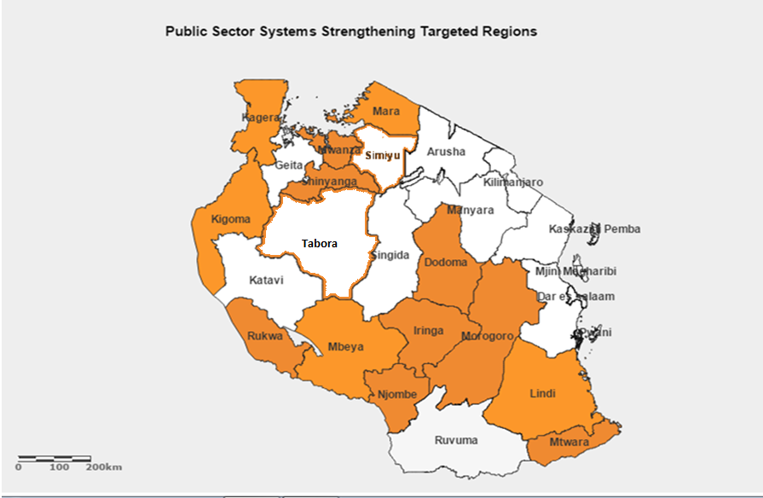
PS3 13 Regions of Mainland Tanzania

Slide 6
PS3 Implementation
Region/LGA level
13 targeted regions of the Tanzania Mainland: Dodoma, Iringa, Kagera, Kigoma, Lindi, Mara, Mbeya, Morogoro, Mtwara, Mwanza, Njombe, Rukwa, and Shinyanga
Support all LGAs in two phases:
Phase I -- two LGAs per region
Phase II -- extend to all remaining LGAs in each region (97 total LGAs)

Slide 7
Five PS3 Components: Governance
Strengthen LGA level citizen engagement
Strengthen LGA committee functioning
Strengthen LGA planning systems including gradual shift to service output or program-based planning and budgeting
Strengthen PFM systems to improve financial management and controls

Slide 8
Five PS3 Components: HR
Strengthen HR planning including:
Support LGAs to distribute or redistribute existing and allocated staff more equitably and efficiently
Support LGAs to submit more evidence-based permit allocation requests
Strengthen incentives for retention
Improve performance management and OPRAS

Slide 9
Five PS3 Components: Finance
Strengthen resource tracking
Support shift towards output-based provider payment systems including implementation of results-based financing (RBF)
Improve funds flow and PFM systems to enable better matching payment to priority services and poor populations

Slide 10
Five PS3 Components: Information Systems
Support LGAs to automate profile information with dashboards for easy accessibility
Strengthen system functionality by improving interoperability and efficiency
Support LGAs to improve quality of data and systems to enable submission of complete and timely reports to higher level
Support LGAs to improve use of data for planning and evidence-based decision making

Slide 11
Five PS3 Components: OR
Engage in dialogue with GOT partners to define systems problems and identify research questions
Perform operations research (OR) studies to support identifying improvements or refining implementation
Feed results of OR studies into governance, HR, finance, and information systems strengthening
Support LGAs in OR and M&E systems strengthening and capacity building

Slide 12
PS3 Implementation Strategy

Slide 13
PS3 Principles
Strengthen GOT programs and systems not build parallel programs or systems
Institutionalize improvements for increased ownership and sustainability
Focus on implementation sequencing
Practical and concrete: identify LGA problems or barriers and support systems strengthening to remove barriers
Collaborate to comparative advantages with all development partner projects in all program and geographic areas

Slide 14
Questions for DPG Health
Implementation strategy: create direct link between systems strengthening and improving service delivery:
What systems need strengthening to improve service delivery?
How best to collaborate with service delivery projects?
Health Financing Strategy/Single National Health Insurance, Health Sector Strategic Plan/SWAp:
How best to link and leverage RBF to enable PFM realignment and broader shift towards output-based payment?
Potential for health basket to shift towards output-based?
How best support HSSP/SWAp?

