Slide 1





Global Health Security
Overview

Slide 2
9 Lessons We Should Learn From
the Ebola Epidemic
Mounting a response after the onset of human-to-human transmission leaves the world vulnerable
"Events" once local can rapidly become global
Weak (health) infrastructure anywhere poses a threat everywhere
Early recognition of a potential threat allows for a global effort to take pre-emptive steps

Slide 3
9 Lessons We Should Learn From the Ebola Epidemic
Ebola, like three-quarters of all emerging disease threats, arises from animal reservoirs
Most new microbes from wildlife come from bats, rodents, non-human primates
Good infection control practices are essential
A strong public health workforce, including trained field epidemiologists, is needed
Laboratory systems and basic laboratory infrastructure needs strengthening

Slide 4
GHSA and the Ebola Outbreak
Prevent
Provide infection-control education and supplies
Provide guidance for behavioral change, including safe burial methods
Establish biosafety and biosecurity protocols
Detect
Improve systems for disease reporting
Provide diagnostics and transport systems for specimens
Hire and train personnel to manage outbreak detection and response
Respond
Establish and staff emergency operations centers
Establish isolation and treatment centers
Provide personal protective equipment, logistic support, and essential supplies
Adapted from Frieden et al., NEJM 2014 Aug 20.

Slide 5


Slide 6

Human and Animal Disease
Reporting for Global Health Protection
GHSA builds country capacity to support achievement of IHR and WAHIS reporting requirements/standards.
Global Health Security – “...the activities required, both proactive and reactive, to minimize vulnerability to acute public health events that endanger the collective health of populations living across geographical regions and international boundaries” (World Health Assembly Report, 2007)
In 2003, SARS cost $30 billion in only 4 months
The anthrax attacks of 2001 infected 22 people, killed 5, and cost more than $1 billion to clean up
The 2009 H1N1 influenza pandemic killed 284,000 people in its first year alone
AIDS spread silently for decades

Slide 7
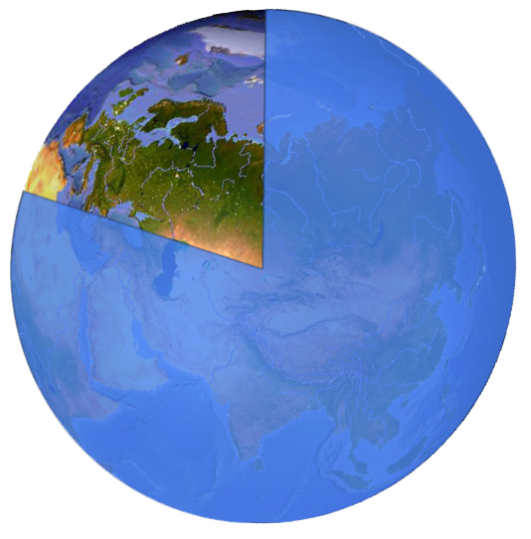
Less than 20% of the world is prepared to respond
All 194 countries of the world committed to International Health Regulations
June 2012 deadline – only 16% fully prepared to detect and respond to pandemics

Slide 8

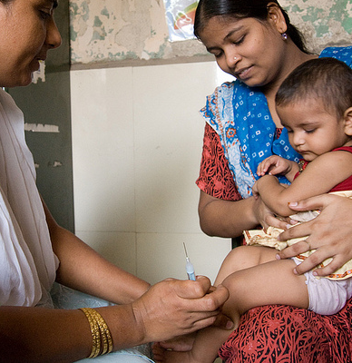
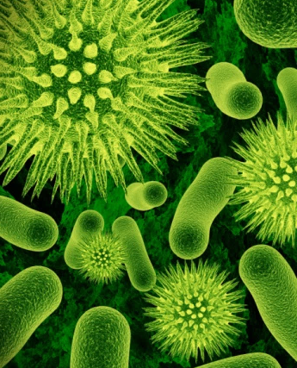
Global Health Security
3
3
3
© David Snyder/CDC Foundation
Risks
Opportunities
Priorities
Emerging
organisms
Drug resistance
Intentional
creation
Public health framework
New lab and surveillance tools
Successful outbreak control
Prevent wherever possible
Detect rapidly
Respond effectively

Slide 9


U.S. Government GHS Landscape
Department of Health and Human Services
  Office of Global Affairs; Office of the Assistant Secretary for Preparedness and Response; CDC; Food and Drug Administration
Department of State
  Biosecurity Engagement Program (BEP); Office of International Health and Biosecurity; Biological Policy Office
U.S. Agency for International Development
  Emerging Pandemic Threats Program
Department of Defense
  Office of the Assistant Secretary for Global Affairs; Office of the Assistant Secretary for Nuclear, Chemical, and Biological Defense Programs; Defense Threat Reduction Agency (DTRA); Armed Forces Health Surveillance Center
Department of Agriculture
  Foreign Agriculture Services, Animal and Plant Health Inspection Service, Agricultural Research Service
Notes:
NCEZID programs receive funding from DoS/BEP, USAID/EPT, and DoD/DTRA/CBEP.
Primary GHS partner is DoD; however it will depend on the country.

Slide 10
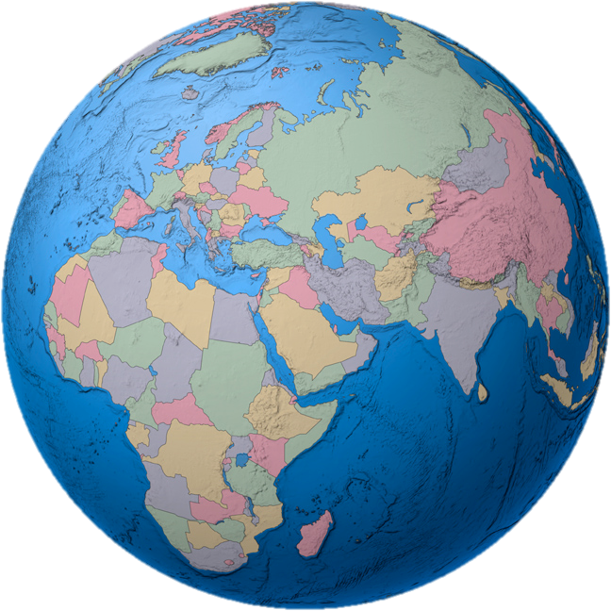
Global Commitment
Nearly 40 countries have joined
Joint development of capacity targets
Endorsed by the G-7 in June 2014
Steering Committee includes ten nations plus WHO, FAO, OIE
Shared technical leadership
4 billion people in at least 30 countries to be protected

Slide 11
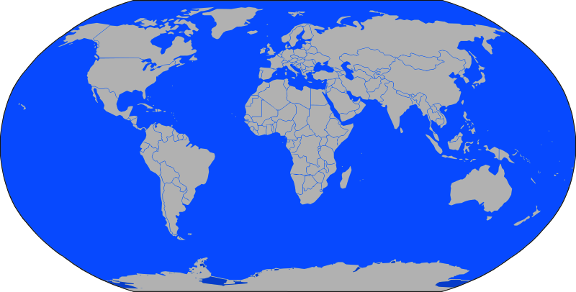
Global Health Security Agenda Timeline
Making the world safer for 4 billion people
CDC/DOD expansion of GHS projects in 12 countries
Countries commit to GHSA Action Packages
4 billion people in at least 30 countries are protected
Less than 20%
of countries fully prepared
2012
2013
2014
2015
By 2020
USAID/DOD collaboration around AI and EPT
Successful GHS Demonstration Projects in 2 countries
Expansion of GHS activities with anticipated appropriations
Notes:
Build on 2013 pilot and 2014 demonstration projects
Expand GHS in up to 10 countries
Goal: Manage emerging threats, enhance early detection, improve confirmation, and ensure highly effective responses to global epidemics and other public health catastrophes
Awards funded through competitive and non-competitive agreements
Focus on Ministries of Health, academic institutions, and private sector entities
Countries selected based on
Risk of emerging epidemics
History of working effectively with CDC
Commitment to contributing their own resources to joint efforts
2013: Highly successful demonstration projects in 2 countries
2014: $40M initiative jointly programmed with DoD/DTRA
2015 proposal: $45M to catalyze progress in 10 countries
Within 5 years: at least 30 countries (with at least 4 billion people) able to prevent, rapidly detect, and effectively respond, to epidemic threats

Slide 12
GHSA Objectives

Slide 13

Global Health Security Agenda a Multi-sectoral approach
Human Health
Animal Health
Environment
Agriculture
Food Security
Economic Growth
Education
Humanitarian Assistance
National Security
Foreign Affairs
Defense
Notes:
The hallmark of the GHSA is its commitment to a multi-sectoral approach as it recognizes that effective prevention, detection, and response efforts require broader collaboration and coordination across sectors than the scope of traditional public health initiatives.
Global health security depends upon collaborations across and with all societal sectors

Slide 14
CDC GHSA Technical Areas
GHSA Technical Area | Description
Biosafety & Biosecurity | Promoting national biosafety and biosecurity systems and establishing bio-risk management training to sustain best practices
Antimicrobial Resistance | Preventing the emergence and spread of antimicrobial-resistant pathogens, including drug-resistant bacteria
Zoonotic Diseases | Preventing the emergence and spread of zoonotic diseases
Immunization | Effective protection through immunization against measles and other epidemic-prone diseases
Surveillance Systems | Strengthening national and international surveillance systems to detect emerging public health threats
Laboratory Systems | Developing a nationwide laboratory system and deploying diagnostic approaches.

Slide 15
CDC GHSA Technical Areas
GHSA Technical Areas | Description
Information Systems (Linking and Reporting) | Developing and linking real-time biosurveillance networks Strengthening capabilities for rapid reporting to the WHO during emergencies
Workforce Development | Training and deploying an effective biosurveillance workforce
Emergency Management | Enhancing Emergency Operations Center capacity and conducting a rapid and effective multi-sectoral response to contain and mitigate public health threats
Medical Counter Measures & Personnel Deployment | Strengthening international infrastructure, policies, and operational frameworks for the deployment of public health and medical personnel internationally in response to emergencies.
Linking Public Health & Law Enforcement | Building linkages between health and law enforcement for the purpose of attribution of bioweapon attacks

Slide 16




2013 GHSA Demo Successes
South Africa
Conducted a biothreat and vulnerability assessment at the biobank/laboratory in Skukuza to identify opportunities for biosafety and biosecurity upgrades
Established a regional animal zoonotic disease station in a rural province north of Hanoi, which will serve as the hub for all animal rabies surveillance activities in the Phu Tho province.
Vietnam
Provided microbiological lab training for detection of selected priority enteric pathogens in 4 districts of 2 states.
Immediately following training, interventions to improve cholera diagnostics
Uganda
Surveillance that covers all reportable diseases in >50% of districts
Upgrade public health labs to meet accreditation
Improve EOC with staffing and technology
India

Slide 17
Tanzania GHSA Planning
Tanzania owned
Existing GHSA activities
5 year roadmap
18 month work plan
Engage other partners

Slide 18
Information
IHR implementation plan 2014-2016
Ebola Preparedness Plan
One Health Strategy
Cooperative Agreements
Our partnerships

Slide 19
Planning Principles
Build off of what exists
Be realistic
Align with Tanzanian priorities
Play to our strengths

Slide 20
Priority Technical Areas
GHSA Technical Areas | Description
Surveillance Systems | Strengthening national and international surveillance systems to detect emerging public health threats
Information Systems (Linking and Reporting) | Developing and linking real-time biosurveillance networks Strengthening capabilities for rapid reporting to the WHO during emergencies
Workforce Development | Training and deploying an effective biosurveillance workforce
Biosafety & Biosecurity | Promoting national biosafety and biosecurity systems and establishing bio-risk management training to sustain best practices
Laboratory Systems | Developing a nationwide laboratory system and deploying diagnostic approaches.
Zoonotic Diseases | Preventing the emergence and spread of zoonotic diseases

Slide 21
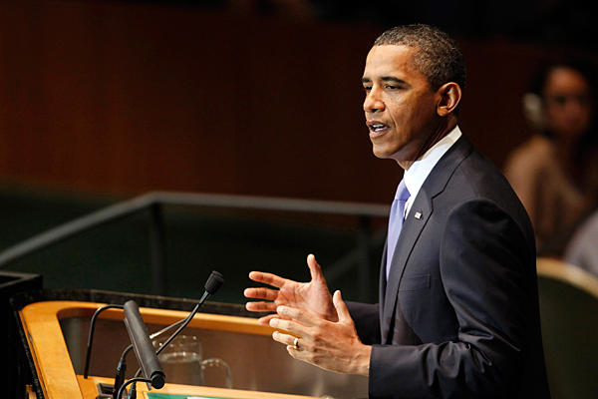
The Global Health Security Agenda (GHSA)
“…We must come together to prevent, and detect and fight every kind of biological danger – whether it’s a pandemic like H1N1, a terrorist threat, or a treatable disease.”
President Barack Obama, 2011
Notes:
[Broad overview of GHSA process, highlighting Sept 26 Ministerial at WH. Lead into the M/E aspects and the Pilot Assessments]
President Obama, during his September, 2011 speech to the UN general assembly, said:
“… And we must come together to prevent, detect, and fight every kind of biological danger – whether it is a pandemic
like H1N1, a terrorist threat, or a treatable disease.”
The Global Health Security Agenda is a multilateral effort to accelerate progress toward global implementation of the International Health Regulations (IHR). Membership in the GHSA is not limited to a defined set of countries.
- GHSA aims to increase political attention, broaden participation from multi-sectoral stakeholders and civil society (e.g., non-governmental organizations, academic and research communities, and the private sector), and focus new commitments, coordination and collaboration in order to protect populations from infectious disease threats and save lives.
- GHSA seeks to accelerate, standardize, and unify response to disease outbreaks and close gaps in surveillance so that disease threats are stopped at the earliest possible opportunity.
21

Slide 22
For More Info on GHSA
http://www.globalhealth.gov

