Slide 1
Tanzania Health Sector Strategic Plan III Mid Term Review Joint Annual Health Sector Review
23 October 2013

Slide 2
Overview of the Presentation The MTR process Findings and assessment Critical issues Recommendations

Slide 3
Process of the MTR
Steering Committee guided the review process
Three elements:
Analytical Report = facts and figures
Community Perspectives Study = interviews, perceptions
MTR team = document study, field visits, interviews
Participatory approach
Four meetings Steering Committee and TL
At least two meetings with all TWGs: July/August
Comments on draft reports: September
Consultative meeting: September
Comments on final draft: October

Slide 4
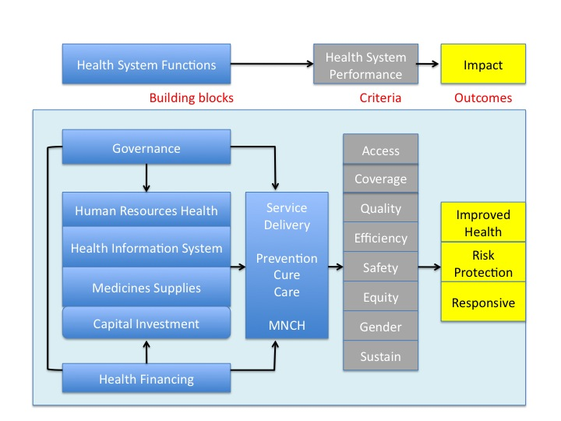
MTR Analytical Framework

Slide 5
Products of MTR
Mid Term Review of the HSSP III, Main Report
Mid Term Analytical Review of the HSSP III
“No Money, No Service”, Community Perspectives on the Health Services in Tanzania
Technical reports
Capital Investment, Governance, Health Care Financing, Health Services, Human Resources for Health, Maternal, Newborn and Child Health, Monitoring & Evaluation, Pharmaceutical Services, Social Welfare
Field visit reports
Geita Region Field Visit, Field Report
Lindi Region Field Visit, Field Report
Mbeya Regional Field Visit, Field Report

Slide 6
Findings and Assessment

Slide 7
Overall findings
Progress in implementation of HSSP III.
Positive developments in all strategic areas
Pace is slower than anticipated
More progress in systems development than in implementation in facilities
Disease control programmes perform better than general and reproductive health services.
Resources constraints major problem of not achieving the goals
Reproductive Health Services is major area of concern, present approach does not work.

Slide 8
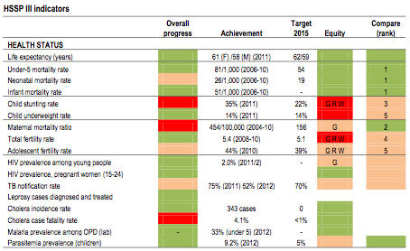
Health Status

Slide 9
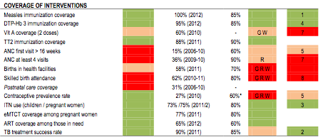
Coverage

Slide 10
Health systems

Slide 11
Access to healthcare
MMAM improves overall geographic accessibility
Expansion is not equitable nationwide, less in rural areas and less Western and Lake Zones
Financial accessibility is not improving
Waivers and exemption schemes not successful
Out-of-pocket expenses are increasing
Community Health Fund not attractive for the poor
Access to medicines
Small improvements, but still serious concern
Major complaint of the general population

Slide 12
Quality
Major steps in systems development
TQIF and many other guidelines in MNCH, disease control, drug prescription
Accreditation and performance management system
Quality systems not sufficiently implemented
Exception HIV, Malaria, TB and child health
Production of human resources increasing
Absorptive capacity of the health sector insufficient
Continuing professional development and professional standards fragmented
Monitoring & Evaluation systems is improving
Innovative methods of data collection and analysis
Evidence-based decision-making in infancy stage

Slide 13
Equity
Equity is improving for many indicators
Inequities are still large, especially reproductive health
Vulnerable people suffer negative social determinants of health
Not sufficient attention in communities
Not enough focus by health workers and health system
Sexual and other gender-based violence are not high on the agenda in the health sector
Women are more vulnerable: Teenage pregnancies, HIV infections, female genital mutilation, rape and sexual abuse
No gender balance in CHSBs and HFGCs
Men dominate the committees

Slide 14
Efficiency
Efficiency is a major issue in the health service delivery
Productivity of health workers often low due to lacking resources (medicines, equipment, funds)
Distribution of health workers is not based on needs
Duplication of work
Parallel systems MOHSW and PMO-RALG
NGOs or development partners increase fragmentation
Delays in disbursement of funding
Direct impact on services in health facilities

Slide 15
Sustainability
Funding for the health sector is far less than envisaged in HSSP III
Per capita funding not increased in real terms
Relative government contribution to the health sector decreasing
Increasing donor dependency
non-basket funding major source of donor funding
In the remaining period HSSP III no significant increase in budget expected

Slide 16
But why? Four crosscutting themes
Health systems development and management
Human resources for health
Improving reproductive health
Managing financial resources

Slide 17
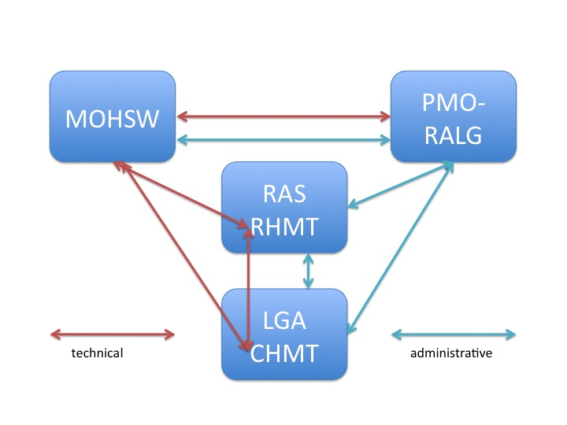
Systems development and management in the health sector: Roles and responsibilities
Regulator
Implementer
Are the communication mechanisms really working?

Slide 18
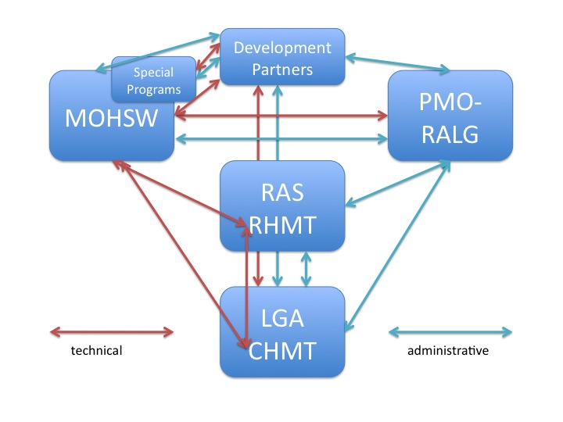
Development Partners and Programmes in management process
Are DPs and programmes part of solution or part of problem?

Slide 19
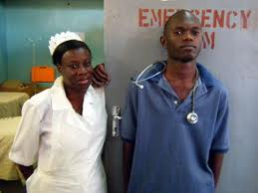
Health workers are the backbone of the health system
Knowledge
Training and CPD
Guidelines and supervision
Diploma and
Re-registration
Skills
Know-how and supplies
Management and materials
Attitudes
Passion and compassion
Incentives and performance assessment

Slide 20
Reproductive health
Reproductive health is not rocket science, but 24/7 commitment
Reproductive health needs a functional health system
Reproductive health needs an holistic approach

Slide 21
Financial Resources
Value for Money: first deliver, then ask for payment
Planning without budget is dreaming, not solving problems
Bureaucratic delays in disbursements kill people

Slide 22
Recommendations

Slide 23
Recommendations in HSSP III
The focus in the remaining period HSSP III should be on Value for Money
Efficiency gains can realised within budget limitations
Increased transparency and accountability will enhance trust of population and partners
Quality focus as the engine for speeding up results
Low-hanging fruits in all areas
Visibility of quality services can improve
Targeted approach for weakest areas
Use available information to improve weakest performers

Slide 24
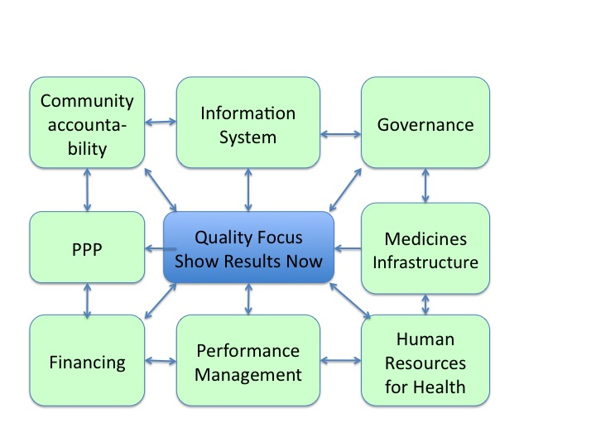
Recommendations in HSSP III

Slide 25
Focus on quality: show results
Accelerate accreditation system
Phased introduction of accreditation
Develop system with private providers and health insurance organisations = level playing field
Independent accreditation body
Focus on community accountability, eradicate corruption
Accreditation serves as basis for identifying weakest performers
Focus on rapid improvements where possible

Slide 26
Pharma and HRH
Pharmaceuticals and supplies
Implement automated logistical management
Use information to identify weakest districts and health facilities and give those technical support in management
Impose measures for rational drug prescription, waste control, pilferage, illegal payments
Independent monitoring medicine supplies
Human Resources for Health
Identify districts with biggest HR constraints, give support in recruitment and retention
Ensure staffing of newly constructed facilities
Improve absorption of newly trained staff

Slide 27
Performance and incentives
Performance management
Use Results Based Financing elements for funding Health Facilities (not only personal incentives)
Work together with health insurance organisations
Incorporate PPP (stimulate private sector to perform)
Make community participation strong component in feedback mechanisms
OPRAS
Make OPRAS essential part of HRM, with career development opportunities

Slide 28
Financing and PPP
Financing
High level lobby for timely disbursements of funds
Disbursement top priority senior management
HBF partners contribute to timely disbursement
Give HFGC control over CHF funds
Public Private Partnership
Stimulate “informal” PPP collaboration in districts, e.g. in social services
Bring private sector in accreditation system
Prioritise urban PPP

Slide 29
M&E and Accountability
Community accountability
Revitalise HFGCs and CHSBs
Make community accountability part of accreditation system
Establish vibrant MOHSW website with transparent information on performance health sector
M&E
Continue roll-out of new DHIS2 in the country
Enhance data quality (e.g. completeness reporting)
Cut-out duplication MOHSW and PMO-RALG report
Use this information for targeted action

Slide 30
Governance and SWAp
Establish high level committee of MOHSW and PMO-RALG to follow-up on action points
Involve chairs of TWGs and
Progress report to senior management
Bring TWGs closer to senior management
improve reporting and enhance coordination (functional TC-SWAP meetings and secretariat)
Tackle MNCH in coordinated manner
Define the elements of holistic approach
DPs to commit to one concerted effort, and cut out fragmentation and competition

Slide 31
Recommendations in short
Bring the systems developed into practice
Spread information; reduce barriers implementation
Increase efficiency
Use decentralised systems, cut-out duplication
Increase coordination at all levels
Use targeted approach
Low hanging fruits first
Use available information for tackling weaknesses
Improve transparency
Show results now

