Slide 1
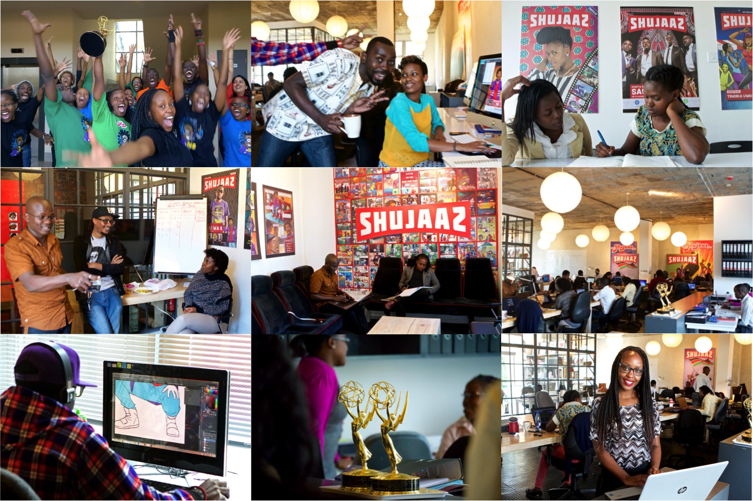

Slide 2



Slide 3


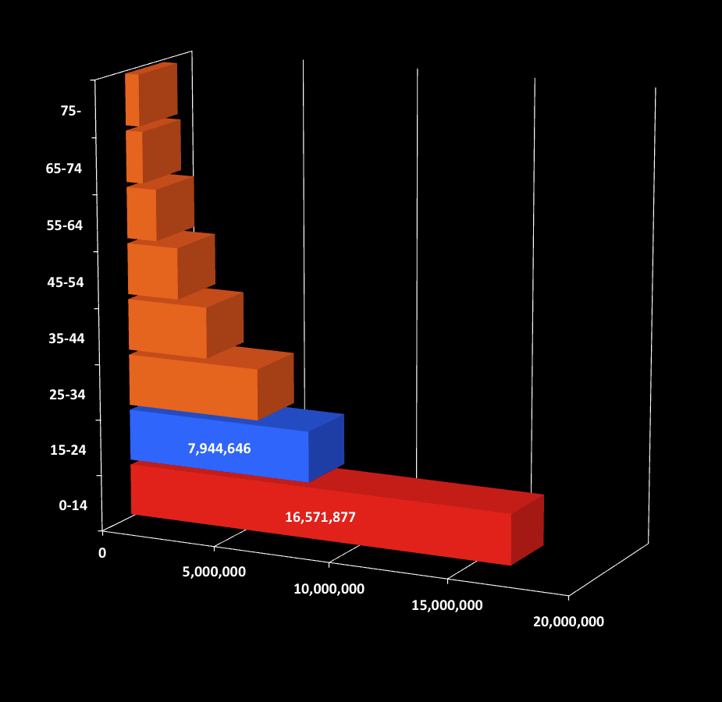
Kenya
Tanzania
2009 census
2012 census

Slide 4
we create social & economic value for young people in Africa
more
more
SEX & MONEY

Slide 5
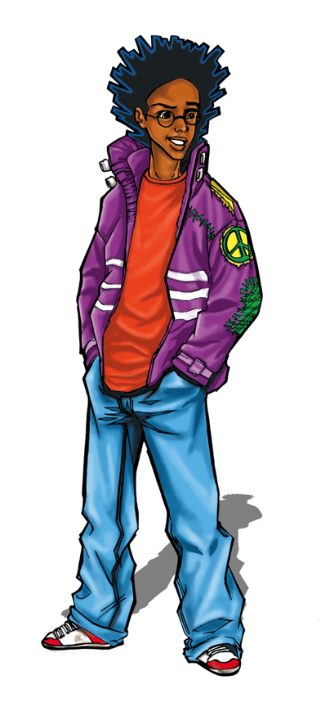

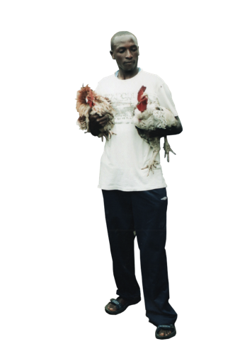








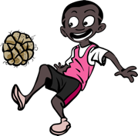

Slide 6








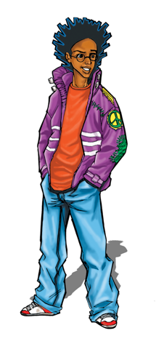









?
conversation

Slide 7


100%
0%
100%
rejection
adoption
Notes:
iNSIGHT NUMBER 2
NORMATIVE change IN OUR WORLD doesn’t happen on the ADOPTION SPACE
SO you better research the rejection SPACE

Slide 8
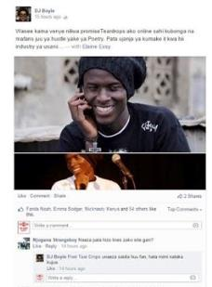
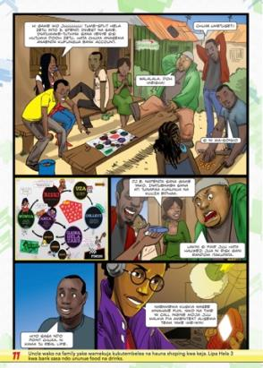
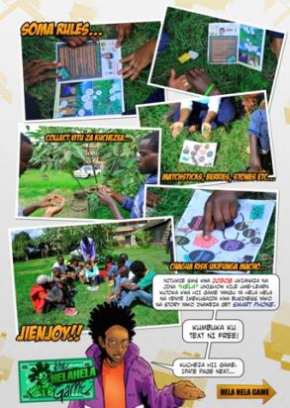
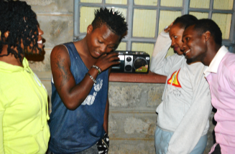

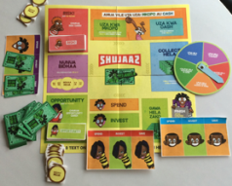

Slide 9





Shujaaz Media in numbers:
COMIC
500,000 monthly
SOCIAL MEDIA
Over 600K+ fans
RADIO
Weekly radio show on 7 radio stations
SMS NETWORK
Over 300K+ fans
Engaging 3 M young people
aged 15-24 in Tanzania
6 M youth aged 15-24 in Kenya

Slide 10

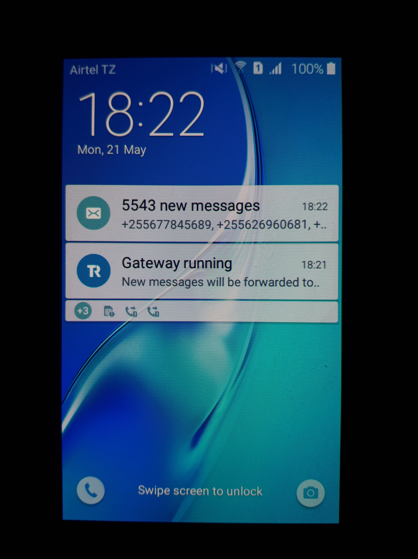
Our Theory Of Change

Slide 11
Our Theory Of Change
Lack of agency
I am not worth it
Why would I care?
No one will listen
It is in god’s hand
Something beautiful
YET - HOPE

Slide 12
Our TOC
#I matter
Validating behaviors / encouragement
Giving them a voice and a place to be heard
Bringing something beautiful
# I can

Slide 13


Taboo-Busting conversations with a bigger / more diverse network
50% of all Kenyan youth
40% of all Kenyan youth
INPUT
OUTPUT
OUTCOME 1
OUTCOME 2
Authentic, compelling media experiences at scale
Intrinsic motivation for change
New Behaviours
BRAND TRUST
User Centred Design
Role models
Real life validation
Multi-topic
“Player 1st”
I see myself /my world
I believe Shujaaz
It solves my problems
All my friends agree
I recommend it
It gives me information
It empowers me
Non-prescriptive
Multi-dimensional
Perceived Norming: “my expectation of what other people think of me”

Slide 14
Shujaaz users compared with non-users
Delays marriage | x 2.7
Delays sexual debut | x 1.9
Delays childbirth | x 1.23
Uses contraception | x 2.8
Household uses digital financial services | x 1.4
Develops ‘agency’ | x 5
Increased monthly income | + $22.7
OUTCOME 2
New Behaviours

Slide 15

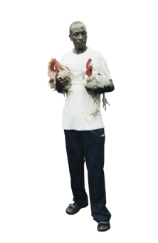
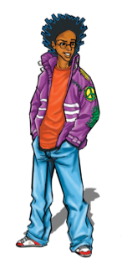

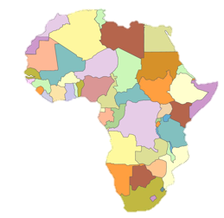
FINANCIALLY FIT
Earn more than they spend
SAVING
Disciplined savers
PROTECTED
Healthy, using modern contraception
ENGAGED
Planning to vote
INDEPENDENT
Make decisions for themselves
Driven, excited about self-employment
Proud, deeply engaged, always learning
Consider hustling their career
20 million East African Youth by 2020

