Slide 1
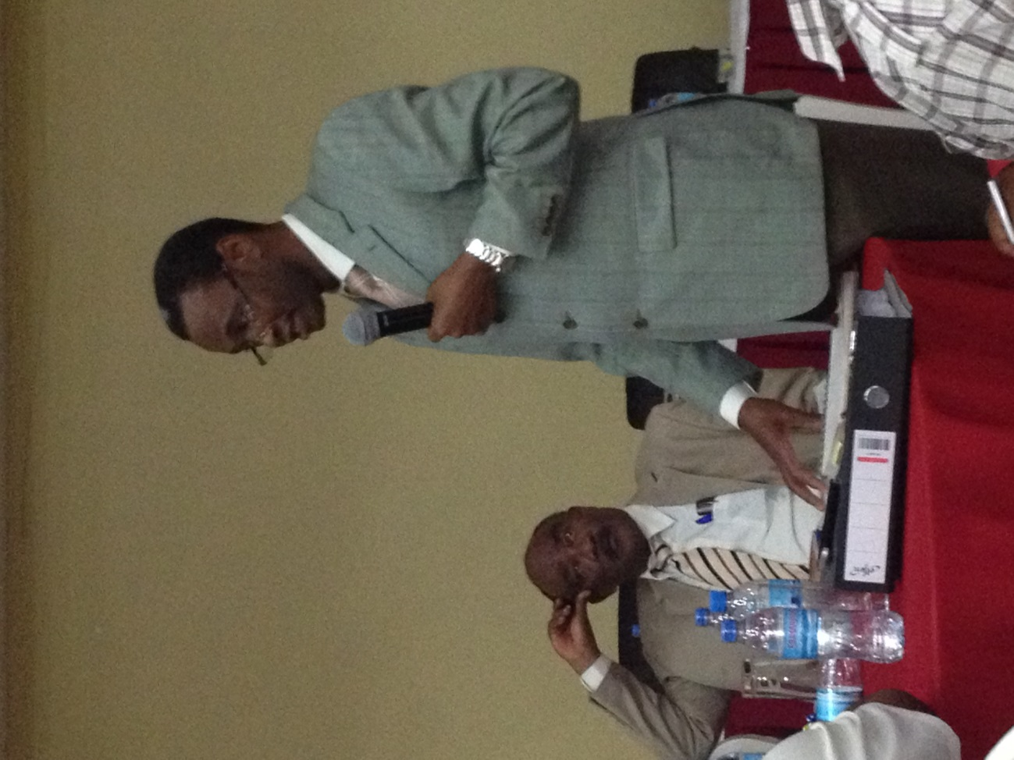
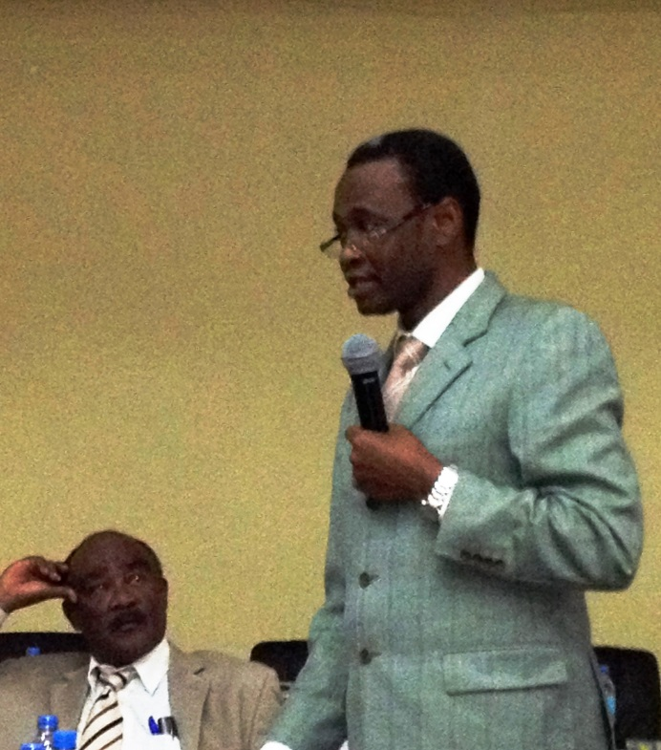
Status of RHMT
Plan for 2014/2015 and Performance 2013/14
Presented: RD Mutagwaba-C,RHS

Slide 2
Presentation Layout
RHMT Budget for 13/14
Assessment of RHMT PLAN 2014/15
RHMT Performance Indicators
Way forward

Slide 3
1. RHMT Budget in FY2013/14
Based on the Annual Report

Slide 4
Source of Funds (FY2013/14)

Slide 5
Source of Funds by Region (FY2013/14)

Slide 6
Expenditure by function

Slide 7
RHMT
Annual Plans 2014/15
Based on the Annual Plans

Slide 8
Availability of Medical Staff

Slide 9
Source of fund by region

Slide 10
RHMT A/Plan Score by Region
 | Region | Score (%) |  | Region | Score (%)
1 | Kagera | 99% | 13 | Mbeya | 90%
2 | Lindi | 98% | 14 | Katavi | 90%
2 | Singida | 98% | 15 | Arusha | 88%
4 | Kigoma | 97% | 15 | Rukwa | 83%
5 | Mara | 97% | 17 | Dodoma | 80%
5 | Mwanza | 96% | 18 | Mtwara | 80%
5 | Shinyanga | 94% | 18 | Manyara | 80%
8 | Kilimanjaro | 92% | 18 | DSM | 76%
8 | Tabora | 92% | 21 | Morogoro | 75%
10 | Iringa | 92% | 22 | Geita | 74%
10 | Ruvuma | 91% | 23 | Njombe | 70%
12 | Pwani | 90% | 23 | Simiyu | 66%
 |  |  | 25 | Tanga | 63%

Slide 11
Achievement (by Indicators)
RHMTs’ Annual Plan
  Timely Submission
  Quality (over 70 % scored in assessment)
2011/12 | 2012/13 | 2013/14 | 2014/15
NA | 19% | 76% | 98%
2011/12 | 2012/13 | 2013/14 | 2014/15
9/21(43%) | 18/21 (86%) | 22/25 (88%) | 92%

Slide 12
2. Roles and Functions of RHMT Institutionalised
Coordination and consultation with PMORALG and other departments of MOHSW
“Functions of Regional Health Management System ” (2014) approved by MOHSW and PMORALG.
“Implementation Arrangement” clarified.

Slide 13
  3. Materials produced/ improved
Functions of Regional Health Management System
RHMT Annual Planning and Reporting Guideline
RMSS Manual (RMSS-C, RMSS-H)
Training Modules on Regional Health Management
Booklet “Good Practices on RHMT (16 cases)
(on RHMT performance, support to RRHMT
and CHMT, Health Service Delivery, etc.)

Slide 14

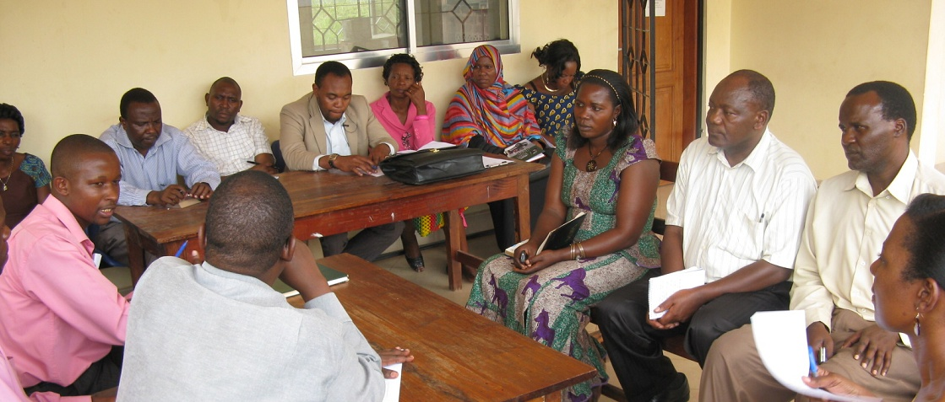
RHMT Performance 2013/14

Slide 15
Indicators for Total Performance
1. Annual Plan Score
2. Quarterly Report Timely Submission
3. Q3-4 Assessment Results
4.R/M Supportive Supervision to the C Implementation Rate
5.Compreh. Hosp Plan timely submission
6.CCHP Approval Rate
7. Good Practice Submission
8. HRH Data Collection Support

Slide 16
Score by Region
Total Performance Assessment
 | Region | Score(%) | 13 | Dodoma | 78
1 | Mbeya | 95 | 14 | Ruvuma | 78
２ | Pwani | 92 | 15 | DSM | 75
３ | Singida | 91 | 16 | Mara | 75
４ | Kagera | 90 | 17 | Katavi | 74
５ | Arusha | 89 | 18 | Rukwa | 74
６ | Kilimanjaro | 88 | 19 | Lindi | 74
７ | Mwanza | 88 | 20 | Tabora | 72
８ | Tanga | 85 | 21 | Mtwara | 70
９ | Iringa | 84 | 22 | Manyara | 70
10 | Shinyanga | 82 | 23 | Njombe | 68
11 | Kigoma | 82 | 24 | Geita | 67
12 | Morogoro | 81 | 25 | Simiyu | 55

Slide 17
Congratulation!
    1st Mbeya
    2nd Pwani
    3rd Singida
    4th Kagera
    5th Arusha
Special Katavi

Slide 18
Challenges and Expectation
Way Forward
Further capacity strengthening at the regional level
  Network of 25 RHMT / Promotion of peer learning
  Utilisation of Good Practice (Tumbi,Mbeya and Dodoma)
  Strengthening RHMT Training Initiatives
  Further strengthening of management capacity at RHMT / RRHMT/CHMT
Further Challenge
  Further organisational capacity strengthening of RRHMT with RHMT support
  Linking the capacity of RHMT to the health service.

Slide 19
END
Thank you for listening!!!

