Slide 1
WHO – EVD Preparedness Update for Tanzania 7th November, 2018 - DPG Meeting

Slide 2
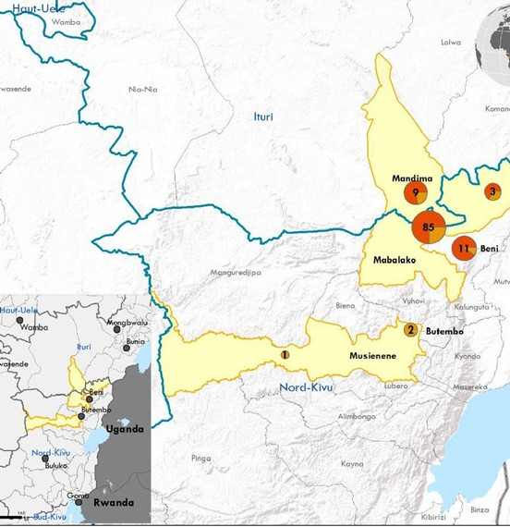
Status of Ebola Outbreak in the Democratic Republic of the Congo (as of 4 November 2018)
300 confirmed and probable EVD cases, including 186 deaths reported
265 confirmed cases and 35 probable with 186 deaths
88 cases have recovered and discharged from ETCs, 91 cases still on admission and 61 suspected cases and 30 confirmed.
2 health workers confirmed positive to EVD raising the total number of health workers affected to 27, 26 confirmed including 3 deaths.
CFR 62%
Over 16000 contacts have been registered and only 4971 are under surveillance
To date 26,687 vaccinated including 9105 health and front-line workers, and 7006 children.
Major Challenges: community reluctance and insecurity in affected areas

Slide 3
Major Achievements in the Past Weeks
National Taskforce for Public Health Emergency meeting was held for the first time in MOH Office in Dodoma on 22 October 2018. Meeting reviewed progress and plans to strengthen EVD preparedness.
WHO and WFP deployed experts to support Ebola Virus Disease preparedness in the areas of Coordination, Risk communication & Community engagement, Case Management & IPC and Logistics.
.
Training conducted for health staff on case management and IPC, laboratory sample collection and packaging, contact tracing, risk communication and incident management system in the three high priority regions.

Slide 4
Major Achievements in the Past Weeks
Capacity Building
Supported EVD training of health teams in the three high priority regions on the following:
Coordination (22)
Case management and IPC (189)
Laboratory sample collection and packaging (45)
Contact tracing (232)
Risk Communication (150)
Incident Management system (22)
Rapid Response Team leadership (19)

Slide 5
Major Achievements in the Past Weeks
Coordination
National Taskforce for Public Health Emergency meeting was held to review progress and plans to strengthen EVD preparedness. The following were the key agreed next steps:
To have a data base for all the teams in the regions for EVD preparedness which can be mobilised within shortest time possible should an importation of EVD occur. The database to be shared to the MOH. Responsible Party RMOs
Insisting on adherence to IPC procedures among health care workers to prevent EVD
Regions to mobilize all available IPC materials and equipment and preposition in the designated ETCs
WHO Country Office received experts deployed to support Ebola Virus Disease preparedness in the areas of:
Coordination
Risk communication & Community engagement
Logistics (deployed by WFP)
IPC/Case Management
WHO EVD Preparedness experts met with MOH sub-committee leads on 2 November, to review checklist and finalize the gaps and map out the way forward.

Slide 6
Major Achievements in the Past Weeks
Zanzibar
Successfully investigated suspect EVD alert in line with the SOPs. EVD was ruled out.
Supported EVD training of health teams on the following:
surveillance (30)
decontamination and Safe and Dignified Burials (14)
contact tracing (24)
EVD ambulance team (6)
Rapid Response Team (19)

Slide 7
Upcoming Activities
Mainland
Printing and roll out EVD Guidelines, SOPs and tools
Conduct simulation exercise in collaboration with AFRO
Conclude scheduled trainings
Resource Mobilization for implementation of the contingency plan
Zanzibar
Conduct After Action Review of the response to the EVD suspected case with the aim to:
Review response actions in line with the performance standards
Identify lessons learnt and areas for improvement
Provide actionable recommendations
Initiate MOH engagement for the establishment of a PHEOC

Slide 8
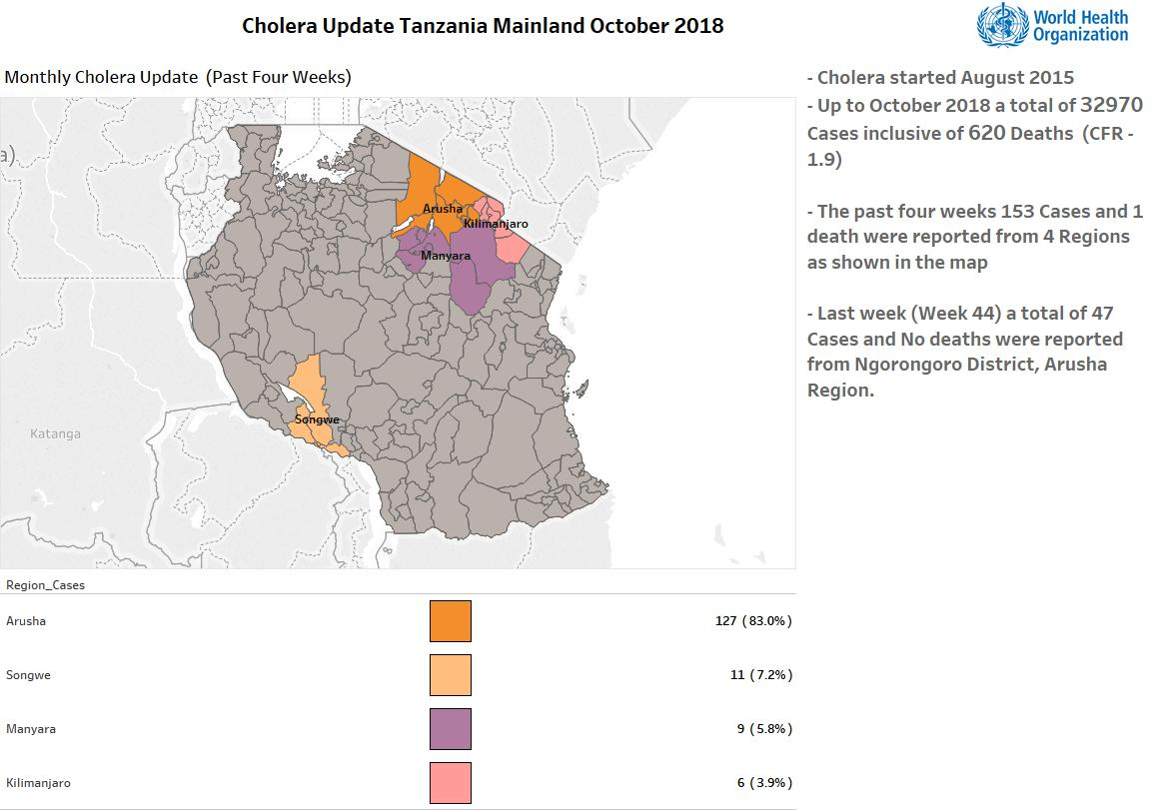

Slide 9
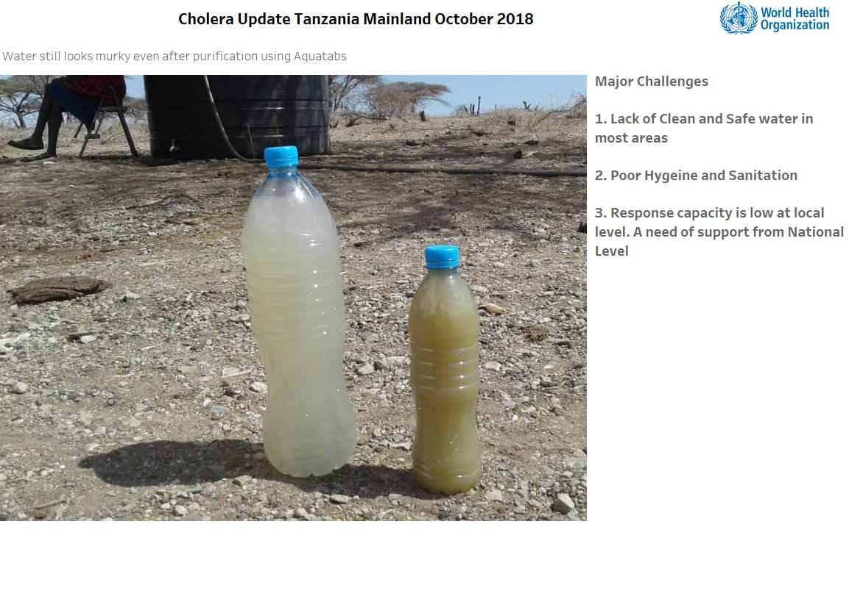

Slide 10
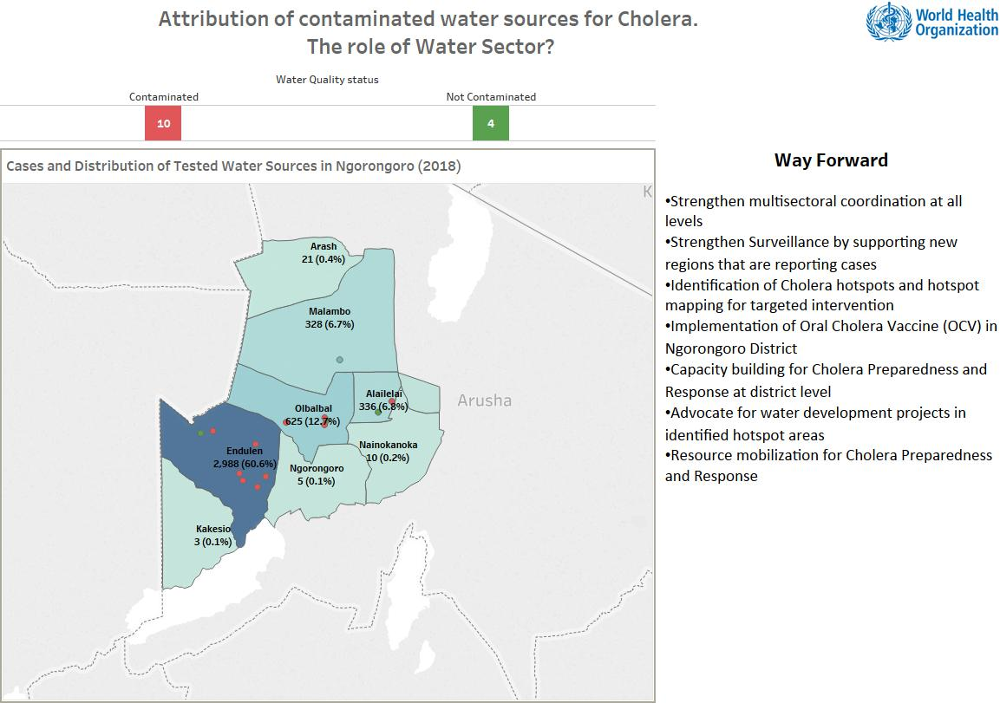

Slide 11
Asante Sana

